Slide 1


Presentation 4 – Better Practices for Water and Energy
Presented by
Chase Weinholtz
Derek Frommel
Gabriela Simoes
Guilherme Barbosa
1

Slide 2
Better Practices for Water Sustainability
2

Slide 3
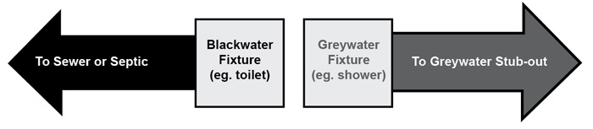

Classifications of Used Water
There are generally a few classifications of water that undergoes treatment.
1. Blackwater – Comes from the Toilet, also called Sewage
2. Greywater – Comes from commercial buildings and households; usually water used for cleaning, cooking, etc.
Dark Greywater – A subcategory of Greywater which contains heavy pollutants, usually from the sink or dishwasher.
3

Slide 4
Desalination

Slide 5
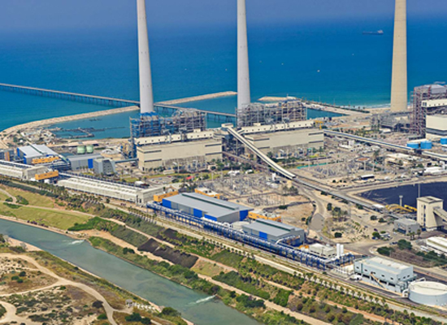
Why Desalination?
Desalination is a group of processes to remove salt and minerals from sea water or polluted water in order to obtain potable drinking water.
Used around the world in regions that lack access to clean water.
7

Slide 6
Primary Methods of Desalination
Multi-Stage Flash (MSF) -- 13.5-25.5 kWh/m³
Makes up more than half the world’s desalination
Involves vaporizing water directly into steam.
A condensate collector stores the pure water vapor
Multiple-Effect Distillation -- 6.5-11 kWh/m³
Similar to MSF except the process takes place in tubes rather than tanks.
This process uses thermal energy for heat transfer that can be reused.

Slide 7
Primary Methods of Desalination
3. Vapor-Compression -- 7-12 kWh/m³
This process involves evaporating and distilling seawater through a vapor compression refrigeration cycle
The compressed vapor is condensed to pure liquid.
4. Reverse Osmosis -- 3-5.5 kWh/m³
Involves filtering water through membrane pores (ranging from 0.1 to 5000 nm).
These membranes can intercept bacteria, protozoa, and other microorganisms.
Very energy efficient `
2

Slide 8
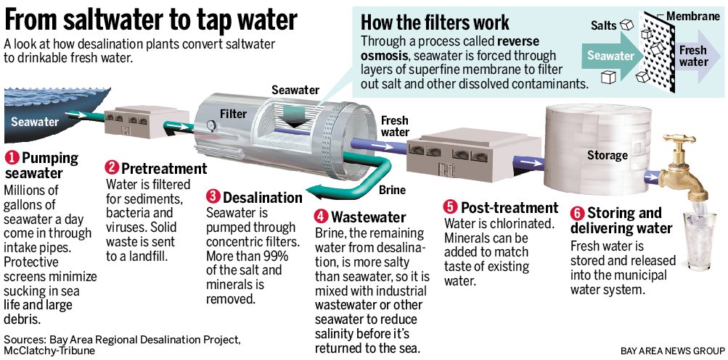
Desalination Process
8
Notes:
http://www.mercurynews.com/science/ci_25859513/nations-largest-ocean-desalination-plant-goes-up-near
http://www.amtaorg.com/water-desalination-processes
http://www.sswm.info/content/desalination

Slide 9
Desalination – On a Large Scale
These plants alone provide Israel with nearly half its freshwater as 2015 and 70% by 2050.
Total Output
520 million m³/year or roughly 420,000 acre ft./year
Assuming an average American household consumes about 0.45 acre ft. per year, these plants could provide water to about 930,000 homes annually.
IDE Technologies
6

Slide 10
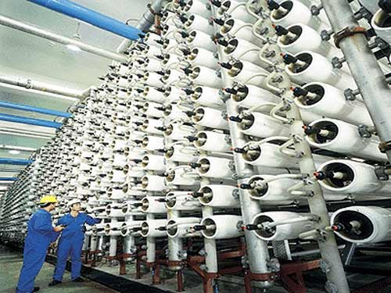
Ashkelon Desalination Plant
The Ashkelon Plant is a well known desalination plant that uses reverse osmosis.
Its maximum output as of 2010 is roughly 120 million m³/year.
IDE Technologies
4

Slide 11
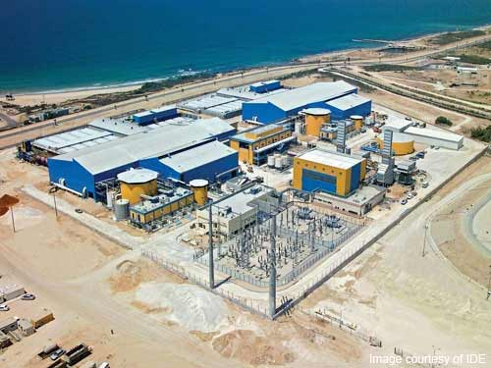
Ashkelon Desalination Site
In fact, the company that developed many of these plants, such as the one in Ashkelon, is constructing the plant in Carlsbad, CA. The company is called IDE Technologies.
IDE Technologies
5

Slide 12
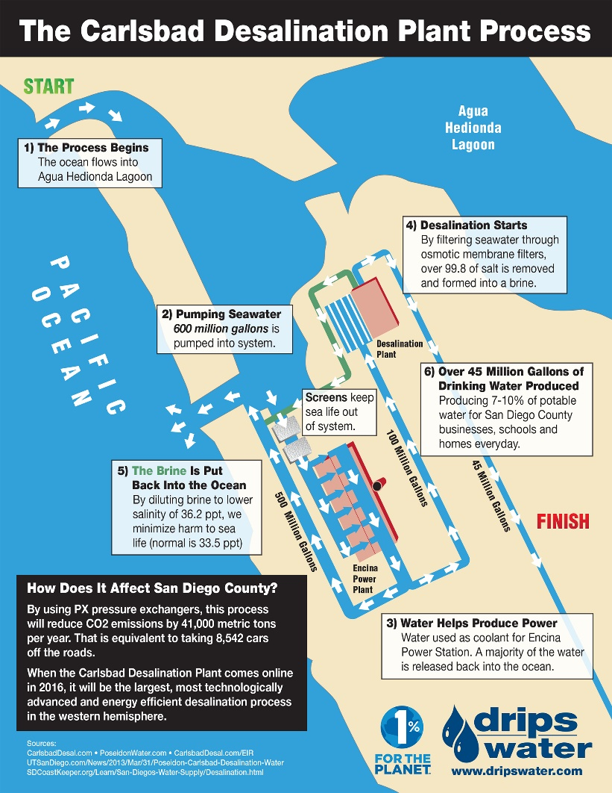
Existing Desalination in CA
Carlsbad plant up and running by end of 2015
Catalina Island
Santa Barbara plant made during drought – never used due to higher cost than traditional methods.
7
Notes:
Ocean water will be pumped to the desalination plant, where it will undergo a sand/anthracite fi ltration process to remove suspended particles from the water. Then, the water will be pumped through reverse-osmosis membranes that remove salts and other dissolved particles. Essential minerals will be added back into the water before it is piped to the Water Authority’s aqueduct as drinking water.
Both plants use reverse osmosis
http://www.sdcwa.org/sites/default/files/desal-carlsbad-fs-single.pdf
http://www.socalgreenrealestateblog.com/will-desalination-solve-californias-water-crisis/
http://www.santabarbaraca.gov/gov/depts/pw/resources/system/sources/desalination.asp
http://butier.com/projects/carlsbad-50-mgd-seawater-desalination-plant-and-product-water-pipeline/

Slide 13
Large Scale Recycling

Slide 14
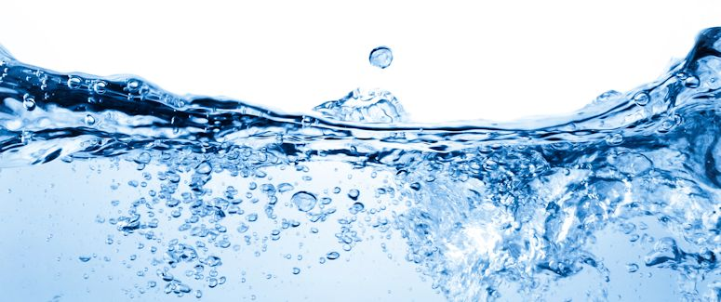
Recycling Water
Involves purifying wastewater or sewage
Water can be used in utilities, irrigation, toilets, and in some cases for drinking and reservoir replenishment
Drinking water obviously must meet higher standards than basic grey water
Image Courtesy of Lenntech
10

Slide 15
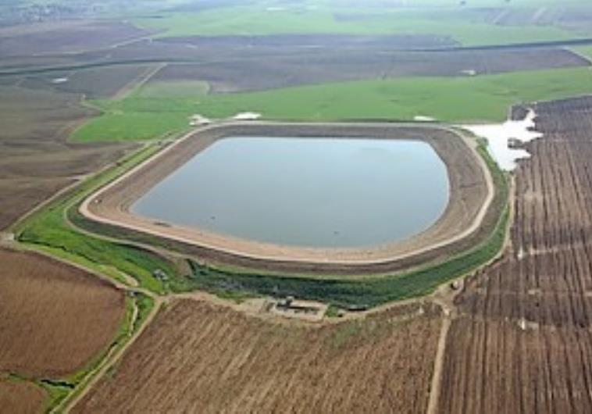
Recycling Water
Once again, Israel is on the forefront of sustainability in terms of water.
As of 2010, they are able to recycle and essentially reuse 80% of their sewage as drinking water.
The Jerusalem Post

Slide 16
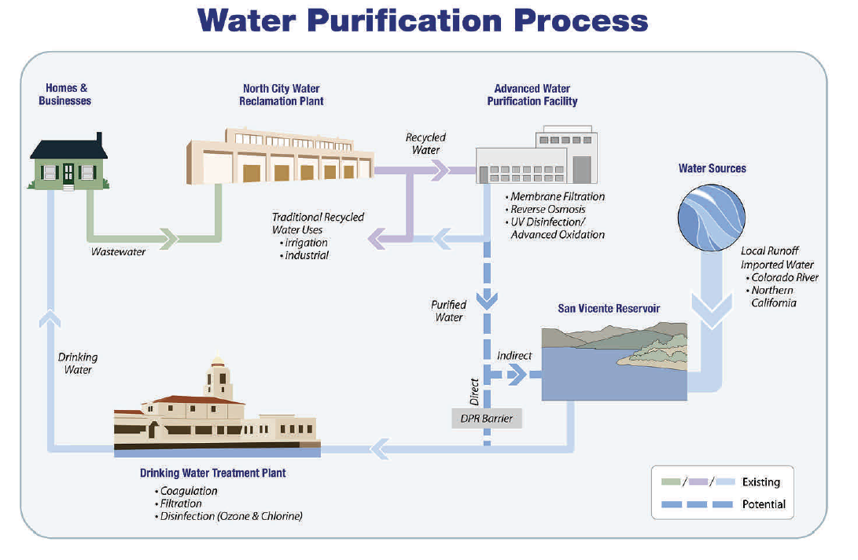
Pure Water San Diego
9

Slide 17
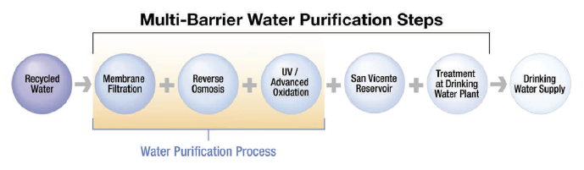
Large Scale Recycling
In order to process large amounts of water in a clean manner, Pure Water and several other companies adopted this idea of Multi-Barrier Steps.
Each step, or barrier, of the purification process is a method of filtering out solid particles, bacteria, and other pollutants.
These steps may seem redundant, but they ensure that every drop of water meets the standards of safe irrigation and/or drinking respectively. (This also reassures the many people who feel doubtful about drinking water that came from sewage.)
Pure Water San Diego
8

Slide 18
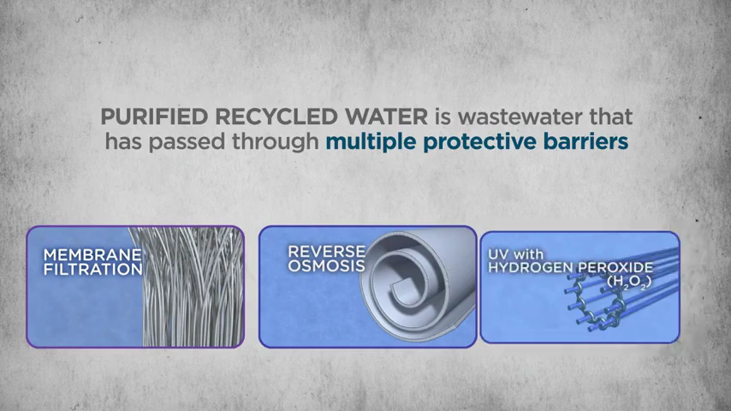
Clean Beyond Common Standard

Slide 19
Policy Issues
Notes:
Public Relations and Practices
Reasonable Use Laws
Water Supply Reliability

Slide 20


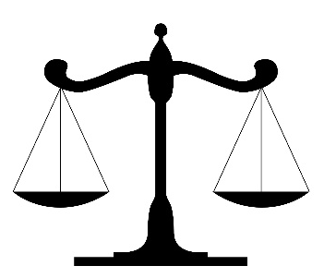
Managing the Public: Triple Appeal Principle
The Id
The Ego
The Super Ego

Slide 21
Managing Public Opinion
Water Recycling is Awe Inspiring for Some – Nauseating to Others

Slide 22
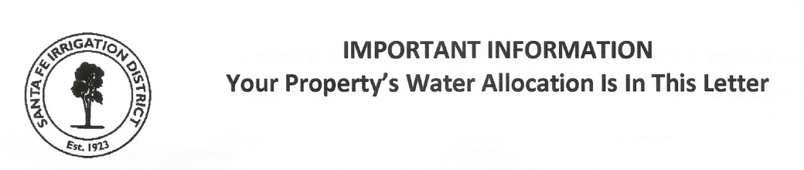

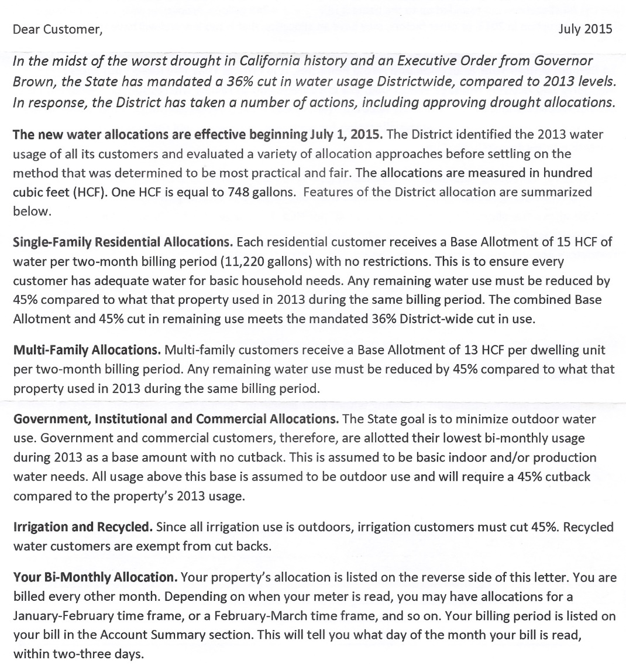
Managing Residential Practices
Updates and Transparency Key for Public Cooperation

Slide 23
Rewarding Practices
“California water servers and users have stepped up big time,” said Felicia Marcus, the chairwoman of the State Water Resources Control Board, as she announced the finding. “That is especially significant because June was really hot. The June numbers tell a story of conscious conservation.” – New York Times

Slide 24
Small Scale Recycling

Slide 25
Immediate and Long-Term Solutions
$12000
10000
8000
6000
4000
2000
Median Cost Per Acre Ft
Source: California Coast Keeper Alliance 2009

Slide 26

Immediate Solution: Efficiency
Urban Water Use Efficiency
California average reduction in June: 27%
Next Goal: 32%
Benefits
Reduce agricultural sacrifice
Minimal resources to enforce

Slide 27
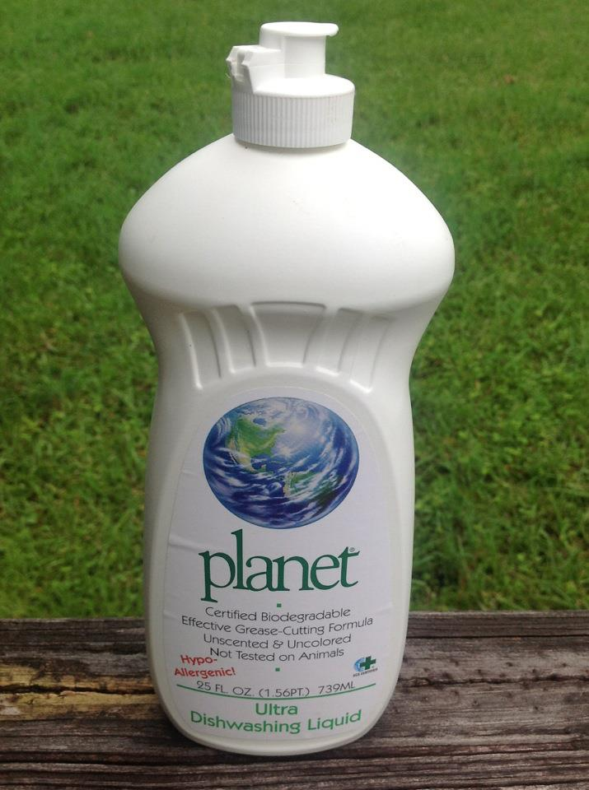
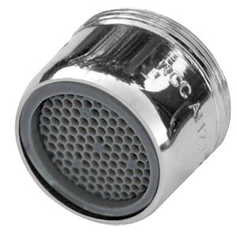
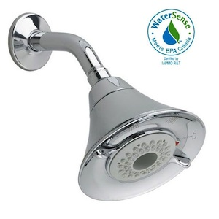
Best Micro-Scale Water-Saving Techniques
Check faucets, pipes, and toilets for leaks can save from 20-200 gallons per day
Water-saving shower heads reduce waste up to 3 gallons per minute
Use Biodegradable soap so water can be easily used on plants
Low-flow faucet aerators
15

Slide 28
Rainwater Capture Systems
Rainwater harvesting is the capture, diversion, and storage of non-potable water for later reuse.
-City of San Diego
Approximately 600 gallons of rainwater can be harvested from one inch of rain falling on a 1,000 square foot roof.
13

Slide 29
Rainwater Capture Systems
Advantages
Reduces demand on other sources such as ground and surface water
Reduces water bill
Water easily made suitable for irrigation
Reduces floods and soil erosion
Disadvantages
Unpredictable rainfall
Initial cost from $200 to $2000
Regular maintenance due to rodents, mosquitoes, algae growth, insects and lizards
Roof types may seep chemicals or animal droppings
Storage limits
14

Slide 30
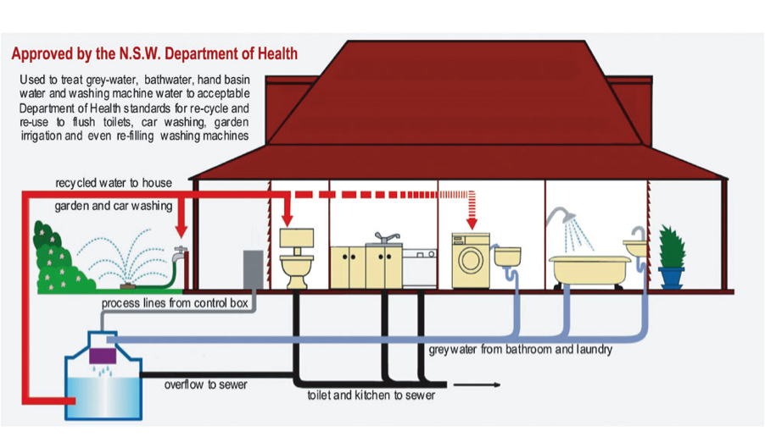
Long-Term Solution: Grey Water Recycling
10

Slide 31
Greywater Recycling Systems
Advantages
Reduce use of potable water to irrigate plants
Reducing monthly water costs
Minimize the burden on the public wastewater treatment system
Complements drought tolerant and native landscapes
Groundwater recharge
Disadvantages
Health standards of the water and quality concerns
Excessive filtration necessary to make water suitable for drinking
11

Slide 32
Cost of Grey Water Systems
High installation cost
Construction for individual buildings and homes are not cost effective.
Long construction and clean up
Data Source: The Guardian 2013

Slide 33
Overcoming Grey Water Cost
Combined Systems
Larger capacity systems accommodate multiple buildings
Highest Water Savings potential
Divided cost between participants
Data Source: Sustainability 2013; doi:10.3390/su5072887

Slide 34

Primary Regulation Updates
Redefine kitchen and dishwasher effluent as difficult to handle grey water.
Allow commercial and multi-family homes
Eliminate the mandate for a redundant irrigation system just for grey water distribution

Slide 35
Better Practices for Energy Sustainability
52

Slide 36
Brazilian PPT…….

Slide 37








Contact us for more information
Phone: +1 619 595 0139
Address:
1088 3rd Ave
San Diego, CA 92101
Wrsc.org geni.org
@wrscnews @geninews
/WorldResourcesSimeCenter
/WRSCorg
Global Energy Network Institute - GENI
GIS Mapping Software
53

Slide 38
Research Team
Ana Brandao
Arnaud Vedy
Ashjeet Talwar
Charlotte Muschamp
Chase Weinholtz
Clay Meyer
Derek Frommel
Daniel Garcia
Gabriela Simoes
Guilherme Barbosa
Leticia Carvalho
Pedro Matos
Renan Micha
Trevor Conger
55

Slide 39

Questions
56

