Slide 1

PUTTING THE SOLAR REVOLUTION IN THE FAST LANE

Slide 2

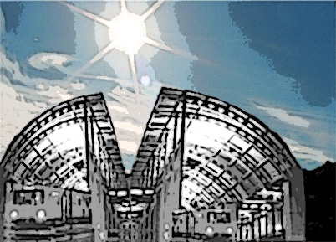
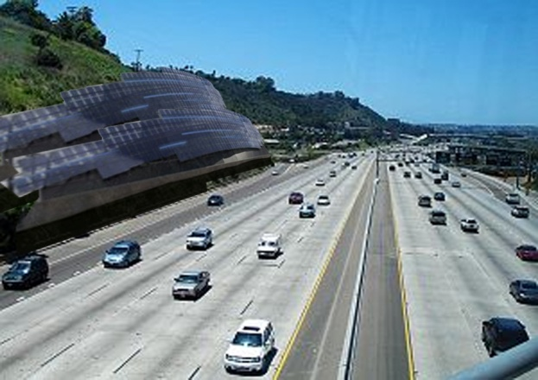
What is Roadside Sun Diego?
Roadside Sun Diego: A public/private solar photovoltaic (PV) infrastructure project that will generate clean energy along San Diego trolley-lines and highway walls, medians and right-of-ways. It will be the first and only road-side solar project in California.
Phase 1: Trolley-line PV project
Phase 2: Highway PV project
Phase 1: Trolley–line PV project
Phase 2: Highway PV project

Slide 3
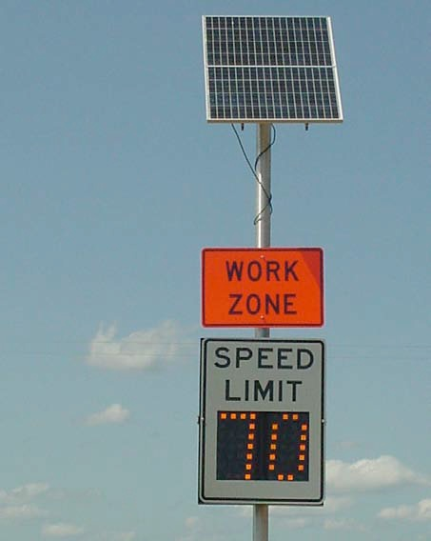
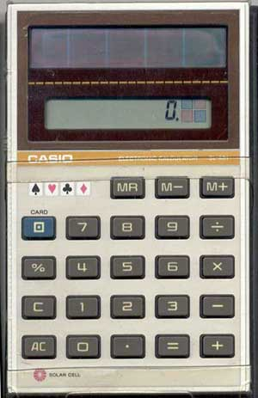
Introduction to ‘Roadside’ Solar
For many years public agencies have made use of solar PV in a range of highway applications. The ability to electrify signs and signals without the investment of resources to the electric grid or operating a diesel generator has made small-scale highway installations of solar PV widely accepted practice.
The decision to use these technologies had little to do with the debates about energy policy or environmental protection and was driven primarily by convenience and savings.
The most common highway application for this technology include call boxes, traffic signals, flashing beacons , weather information systems and traffic counters.
Before ‘global warming’ and before Solyndra…There was my casio…

Slide 4
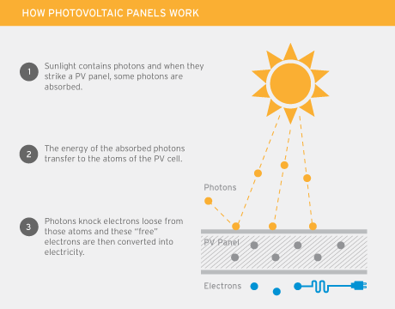
Solar 101: Overview of Solar Energy Technologies and Their Uses
There are two basic technologies that can harness the energy of the sun to generate electricity: concentrating solar power (CSP) and solar photovoltaics (PV).
Concentrating solar power: CSP technologies use mirrors to concentrate the thermal energy of sunlight to make steam and produce electric power using turbine or heat engine. CSP systems require substantial tracts of land, on a scale of 500 to 1000 acres in climates with limited cloud cover to be cost effective.
Solar Photovoltaics: PV technologies are solid state semiconductors that directly convert direct ad indirect sunlight into electricity. Solar PV is a distributed electric power generating technology that produces electricity at or near the place where it is used.
Most common example, small PV systems are often installed on building roofs (a deployment called rooftop solar PV).
Costs
Financial
Transaction
Aesthetics
Transfer of ownership

Slide 5
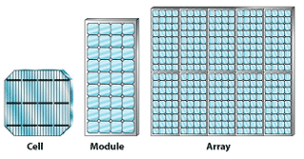
Solar 101: Solar PV cells, panels and arrays
The basic building block of a solar PV system is the solar cell. Solar cells are solid-state, semiconductor devices that convert the energy in sunlight into electricity. A variety of semi conductor materials can be used in the manufacture of solar cells but the most common material in the marketplace is crystalline silicon.
Individually, PV cells can only produce a small amount of power so they are connected to form a PV module, or solar panel. MODULE = PANEL
To provide electrical insulation and protect against environmental corrosion, the panel is encased in a transparent material referred to as an encapsulant.
To provide structural integrity the panel is mounted on top of a rigid flat surface or substrate. A transparent cover film, commonly made glass, further protects the components from the elements.

Slide 6
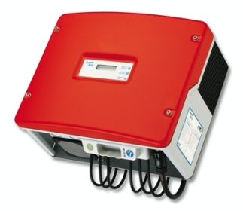
Solar 101: Inverters
Power condition units, or power inverters, are specialized pieces of electrical equipment that convert the direct-current (dc) electricity produced by the photovoltaic panels into alternating-current (ac) electricity that can be placed on the electric grid.
The number of inverters in a solar array will vary depending on the specifications of the equipment involved, but a common configuration is to utilize one inverter for each parallel string.
Once the electricity is converted to ac, it can be placed onto the local electricity distribution grid through a grid interconnection.
The number of inverters will depend on their size (250 kW, 500kW, etc.) and the size of the array.

Slide 7
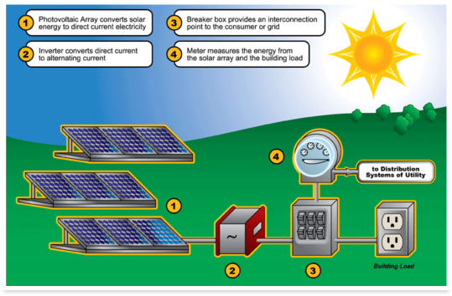
Solar 101: Interconnection
The term interconnection refers to connecting a PV system to the electric grid – a procedure managed by the local electric utility. Most electric utilities require that a grid-tied PV system meets specific interconnection standards.
These standards typically require the installation of disconnect switches– safety equipment that can interrupt the flow of electricity from the PV system in an emergency. They also ensure that power inverters and other electrical equipment, like meters, meet certain electrical codes or standards.
These requirements are usually detailed in an interconnection agreement signed by the electric utility and the solar PV system owner.

Slide 8
International Applications
Roadside solar solutions have been successful in Europe for years
Solar Tunnel Antwerp, Belgium June, 2011: The tunnel on the Paris-to-Amsterdam line topped with 16,000 solar panels went on line in 2011 and generates enough electricity to power the Antwerp station and Belgian train network.
Cost: $22.8M
Size: 2.6 miles
Output: 3,300 MW

Slide 9
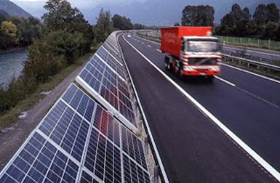
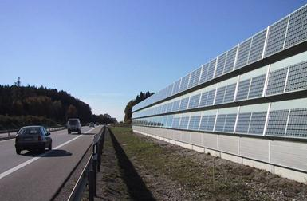
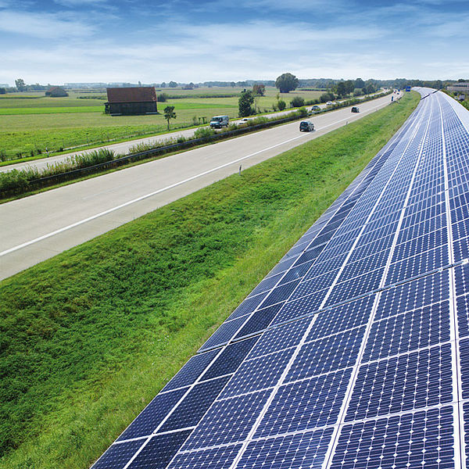
International Applications
‘PV Soundless’ Project – Freising, Germany
The worlds largest PV sound barrier with a capacity of 500 kWp was installed at Freising in Germany, next to the Munich airport and has been operational since September 2003.
The main objective of this project was to demonstrate and promote an innovative multiple-function solar PV technology. A new ceramic based PV panel was developed and tested for this project. The total power capacity of the Freising sound barrier adds up to 500 kWp at a length of approximately 1 km.

Slide 10
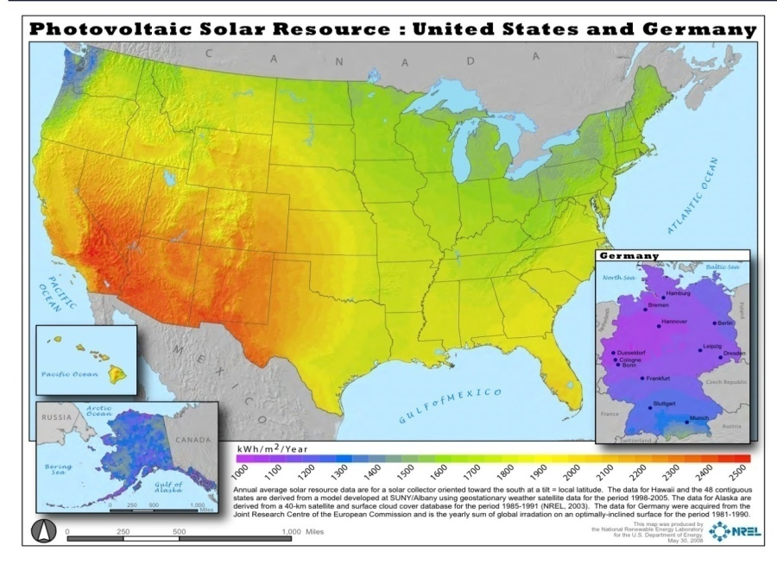
Domestic Capacity
The U.S. has sufficient capacity for similar projects…
Most parts of the U.S. receive more solar radiation than Germany, ranked first in the world for cumulative installed solar capacity. Take note of the U.S. southwest, Southern California specifically.

Slide 11
Domestic Applications
Local projects exist as proof of concept in the U.S. since 2008
The Oregon Solar Highway Demonstration Project, a 104 kilowatt system located at the interchange of I-5 and I-205 near Portland Oregon, was initiated as a proof-of-concept project. This project demonstrates that renewable energy development using existing public infrastructure can compliment traditional transportation activities and functions.

Slide 12
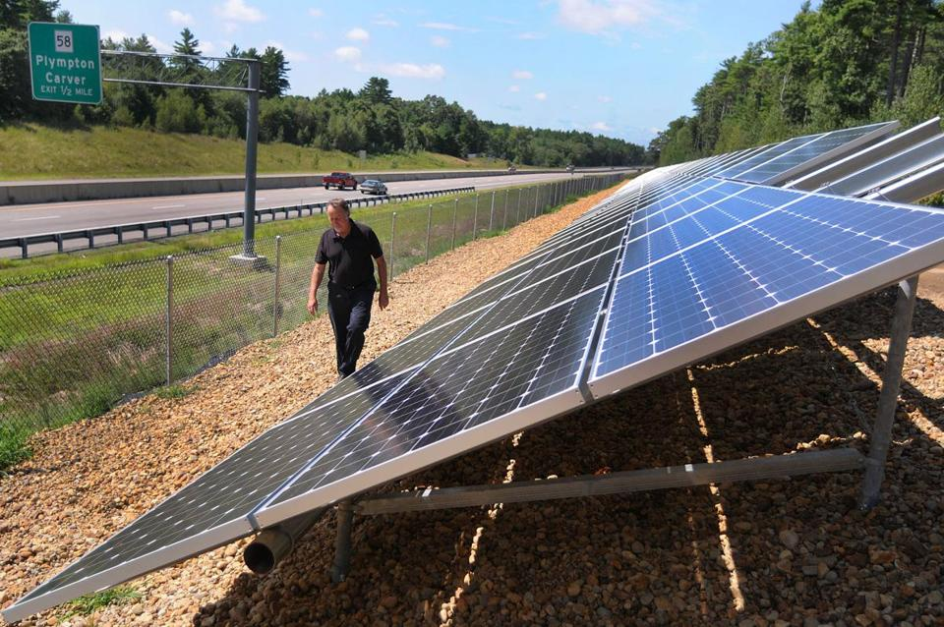

Domestic Applications
Massachusetts Route 44 project: In August 2012, the first solar project built along a major highway right-of-way on the East Coast has begun producing energy to power the town of Carver’s water-treatment plant.
Built along Route 44 on an easement awarded by the state to the town, the 99-kilowatt project makes use of the highway’s east-west orientation to erect an array of south-facing solar panels in a nearly ideal location in terms of power-generating efficiency
California Highway 50 Solar Project: Initially presented in the Summer of 2007, the Sacramento Municipal Utility District (SMUD) and the California Department of Transportation (Caltrans) had been coordinating to develop solar energy projects along Highway 50 in Sacramento County. The proposed 1.4 MW project would have been the first of its kind in the state. However, in November 2011, the project was canceled due to economic reasons.
Transportation and government agencies in Colorado, Florida and Missouri have completed assessments evaluating the potential for renewable energy generations at rest areas, service plazas and along highway right-of-ways.

Slide 13
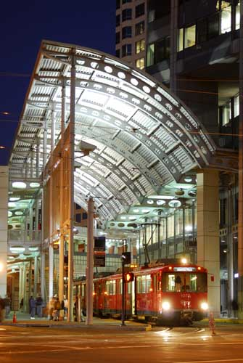
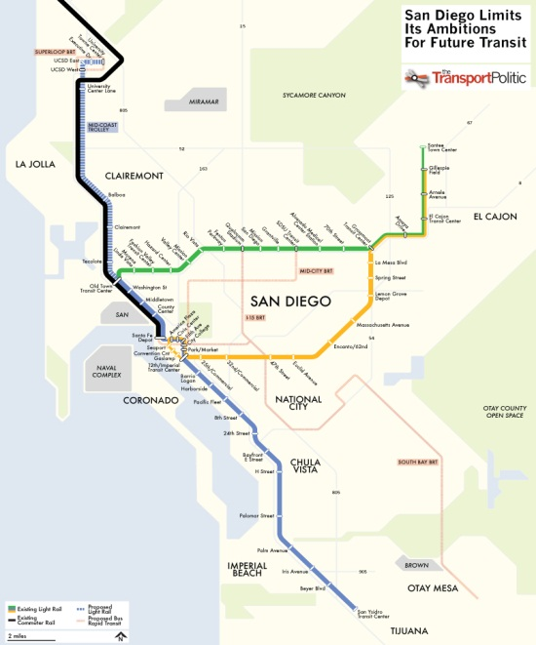
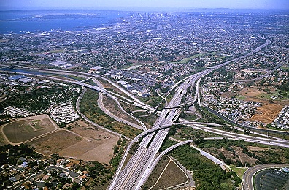

Plans for Local Applications
What if… state and local agencies partnered with private utilities and solar developers to leverage even a portion of San Diego’s 300 miles of highway and/or 65 miles of trolley line to site this solution?

Slide 14

Plans for Local Applications
Phase 1: Project Sunroof - Trolley-line PV project
Phase 1A: Pilot project - 5 miles
Proposed site: Along the 11 miles of light-rail transit line expansion to La Jolla/UTC.
Rooftop design allows seamless integration to existing trolley railway electrification system.
Aims to create enough electricity to power a substantial percentage (80% to 90%) of the existing trolley line.
Less invasive to traffic.
Phase 1B: Expansion to an additional 20 miles of trolley line
Transfer excess power back to the grid.
Opportunity to lease ad space to generate additional revenue throughout the life of the project.
San Diego currently has 54 miles of Trolley service and plans are progressing to expand the trolley 11 miles from old town to UCSD and University Town Center. (Potentially 65 miles).

Slide 15

Plans for Local Applications
Phase 2: Roadside Sun Diego - Highway PV project
With the automobile being the primary means of transportation for over 80 percent of its residents, San Diego is served by a network of 300 miles of highways.
PV systems can be placed on highway walls, medians and right of ways.
Traditional large-scale PV projects required enormous amounts of open space, which prevented siting systems in heavily populated areas, far from existing transmission lines.
Road-side PV can be seamlessly integrated with the existing infrastructure along San Diego’s highway system in metropolitan areas.
This PV system , covering a proposed 50 miles, would aim to power lighting and signage along highways, while transferring excess power to the grid. Distributed Generation arrangements can be negotiated with the communities that are closest to the systems.

Slide 16
Plans for Local Applications: System Comparison
Project | Location | Application | Size | Capacity | Generation | Cost
PV Soundless' Project | Freisburg, Germany | The main objective of this project, located along a highway which is located next to the Munich airport, was to demonstrate and promote an innovative multiple-function solar photovoltaic technology for utilization as PV panel and as novel construction element for the sound barrier and for the construction industry. | 6750 ceramic panels and 1080 standard panels, 1km (.62 miles) | 500kw | approx. 783,000kwh annually (adjusted for dc/ac inverter conversion at 90%) | ???
Oregon Solar Highway | Portland, Oregon | The demonstration project serves as proof-of-concept for U.S. Application and an example of renewable energy development using existing public infrastructure can compliment traditional transportation activities and functions. The array produces enough electricity to light the interchange where the system is located. | 594 panels | 104 kw (dc) | actual reported: 130,000kwh (ac) annually | $1.25M
Water Treatment Array | Carver, Massachusetts | The project is a high-efficiency use of underutilized property that solar power advocates and government officials say can serve as an example for future projects on major roads such as the Massachusetts Turnpike. For Carver, the renewable power supply will save about $3,000 a month in electricity costs, Hunter said. | 330 panels, 600-foot-long series of linked panels, which sits on a 1¼-acre site | 99 kw | approx. 130,590kwh annually (adjusted for dc/ac inverter conversion at 90%) | $500K
Solar Tunnel | Antwerp, Belgium | The solar energy will be used in the Antwerp North-South junction (including Antwerp Central Station) to power the station and 4000 conventional and high speed trains annually, equivalent to the average annual electricity consumption of nearly 1,000 homes, and decrease CO2 emissions by 2,400 tons per year. | 2 miles, 16,000 panels | 4MW | actual reported: 3300 MWh annually | $22.9M
Roadside Sun Diego: Phase 1 - Project Sunroof (Trolley-line) | San Diego, California | Phase 1A: Sited along 5 of the 11 miles of light-rail transit line expansion to La Jolla/UTC, it's rooftop design allows seamless integration to existing trolley railway electrification system and aims to create enough electricity to power a substantial percentage (80% to 90%) of the existing trolley line. Phase 1B: Aims to create enough electricity to power the remaining Trolley line, transfer excess power back to the grid and possibly leverage the opportunity to lease ad space to generate additional revenue throughout the life of the project. | Phase 1A: 2000 panels per mile, 5 mile system (10K 250 watt panels); Phase 1B: 2000 panels per mile, the 20 mile system (40K 250 watt panels) PHASE 1 TOTAL: 50,000 Panels over 25 miles | Phase 1A - 2.5MW; Phase 1B - 10MW | Phase 1A - approx. 4,106.25MWh annually; Phase 1B - approx. 16,425MWh annually (adjusted for dc/ac inverter conversion at 90%) PHASE 1 TOTAL: approx. 20,531.25MWh annually | Phase 1: The panel cost is around 35-40% of the total installed cost of a solar energy system. At the market price $1 per watt, the cost of PV panels for this phase would approach $12.5M.
Roadside Sun Diego: Phase 2 (Highway walls, medians and right of ways) | San Diego, California | Phase 2: Aims to power lighting and signage along highways, while transferring excess power to the grid to communities and neighborhoods they abut. Depending on where they are sited, a possible Distributed Generation (DG) arrangement can be negotiated. | Phase 2: 2000 panels per mile, the 50 mile system (100K 250 watt panels) PHASE 2 TOTAL: 100,000 PANELS 50 miles. | Phase 2 - 25MW | Phase 2 - approx. 41,062.5MWh annually. (adjusted for dc/ac inverter conversion at 90%) | Phase 2: The panel cost is around 35-40% of the total installed cost of a solar energy system. At the market price $1 per watt, the cost of PV panels for this phase would approach $25M. TOTAL Project total: $62.5M

Slide 17

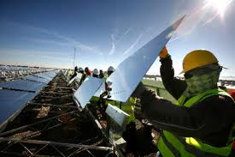
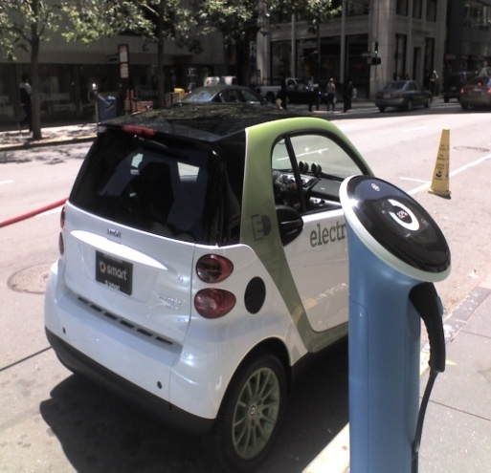
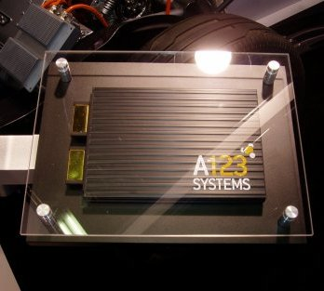
Why?
Clean, efficient solution to solve state-local energy demands…
The ‘Blackout of 2011’ San Diego, CA.
Jobs, industry innovation…
Electric car & charging stations
Created demand and attracted ‘synergistic’ industries to San Diego…
Lithium battery manufacturing

Slide 18

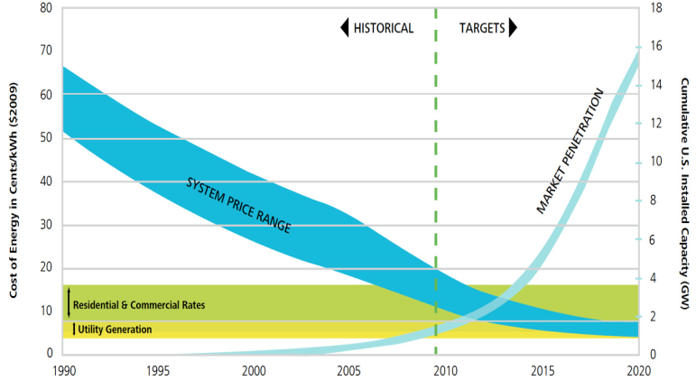

Why?
Market conditions are prime for such a solution…
Competitiveness: Power generated from solar photovoltaic (PV) panels is much closer to competitiveness with conventional electricity generation than many policy-makers and commentators have realized, according to a new working paper on the subject, released by research company Bloomberg New Energy Finance . Recent reductions in PV prices are likely to be sustainable. While overcapacity has caused severe pain for manufacturers, the price falls are primarily a reflection of reductions in manufacturing costs, not solely a reflection of stock liquidation and other short-run factors.
Price Parity: The U.S. Dept. of Energy (DOE) has established a goal for solar PV to reach price parity with other forms of electric generation by the year 2015 . www.DOE.gov The solar PV industry is approaching this threshold. In parts of the country with relatively high electricity prices , abundant sunshine and well-established financial incentives, solar has already reached this important threshold.
Grid Parity: Levelized cost of electricity (LCOE) is the price at which electricity must be generated from a specific source to account for the cost of the energy-generating system. The LCOE for solar PV will continue to decrease due to declining capital costs and increasing capacity factor . Solar PV technology will reach grid parity in the U.S. for some PV projects in 2014; by 2017 most regions in the country will reach grid parity in alignment with average electricity prices in the residential sector, according to a new GlobalData report. The report predicts China will reach grid parity for solar inmost regions by 2015-2016.

Slide 19

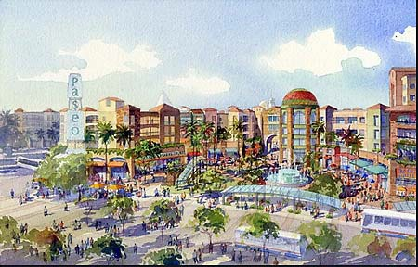



Why?
The program concept was consistent with the overall goals and objectives of local agencies’ mission…
SANDAG, the San Diego Association of Governments, has developed the Regional Comprehensive Plan (RCP) and its Integrated Regional Infrastructure Strategy (IRIS), to help achieve the goal of responding to population growth and creating a sustainable region. Among important infrastructure areas, the IRIS focuses on Transportation (airports, transit, highways) and Energy Supply & Delivery Systems.

Slide 20
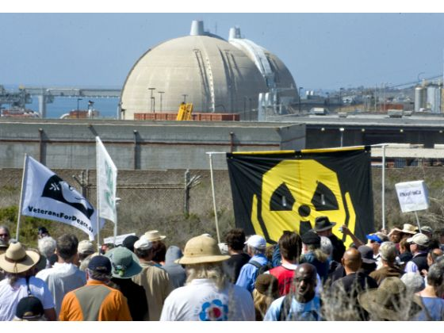

Why?
Alternative to nuclear energy
Questions about the San Onofre Nuclear Energy Generation Station’s integrity have lead to public protest.

Slide 21


How?
Through a public/private partnership and a Power Purchase Agreement (PPA) …
a host agency could avoid upfront capital investment and ongoing operating and maintenance responsibilities while securing a long-term, predictable price for electricity, often initially at a price lower than current utility rates.
Through this arrangement…
a private sector partner could receive revenue from electricity sales to the host agency and capture the tax benefits and financial incentives made available from developing the project.

Slide 22


How?
Well-established federal and state incentives to fund such a solution…
Federal Funding Incentives
Investment tax credits (ITC)
ITC’s provide a tax credit to taxpayers equal to 30% of qualified expenditures for investments in solar PV systems. To qualify for the ITC, the system must be placed in service, installed and ready to use prior to December 31, 2016. [Section 1603 of the American Recovery and Reinvestment Act (ARRA)]
Modified Accelerated Cost-Recovery System (MACRS)
MACRS is the method for calculating federal accelerated depreciation of business equipment. Under MACRS, a taxpayer can recover their capital investments through annual depreciation deductions over a specified number of years.
State Funding Incentives
California Solar Initiative (CSI)
The CSI is a ratepayer-funded purchase incentive to promote the installation of new solar energy systems at homes and businesses throughout the state. The goals of the CSI are to install 3000 MW of new solar generation capacity .
Renewable Portfolio Standards (RPS)
Established and accelerated by Senate Bills in 2002 & 2006, California’s RPS obligated investor owned utilities (IOUs) to make 20% of the power they deliver to consumers from renewable sources by 2010, (originally 2017). The CPUC and the CEC have set their sights even higher by raising this amount to 33% by 2020.

Slide 23

How? Program costs
While innovative public-private partnerships may allow an agency to avoid the upfront capital cost of the solar PV system, there will likely be some programmatic costs the agency must fund.
Some of these costs are associated with internal agency staff time, while others may be costs for external consulting services such as external legal counsel and professional or technical services.
It may be possible to absorb these costs within existing programmatic budgets but it may also be necessary to secure funding from other sources such as federal grants or programmatic requests.

Slide 24

How? Economic Analysis
Public agencies have a duty to invest scarce public resources wisely, so before proceeding with a project the project team should complete a thorough financial evaluation. At the most basic level, determining the financial viability of the project is a matter of comparing project expenses and revenues over the life of the project. Established financial metrics can assist decision makers in judging if a proposed project is worth undertaking from a purely economic perspective.
Project Life-cycle Cost Analysis: This should include estimated capital and operation and maintenance (O&M) costs.
Project Revenues: This analysis should include project income, the value of utility, state and federal incentives and tax credits, and electricity cost savings. Project income includes revenues generated from the sale of electricity under net metering or a utility generation incentive.
Analytical Tools: A number of public domain and private party software applications have been developed to assist with economic analysis including the National Renewable Energy Lab’s (NREL) System Advisor Model. (http://www.nrel.gov/analysis/sam )
The NREL model is a powerful tool that can be used to generate estimates of system costs, energy outputs and cash flows based on defined factors such as project location, system specifications and financial assumptions. The SAM model also calculates several financial metrics including net present value, internal rate of return and simple playback. Project partners should also be expected to provide prof formas detailing their understanding of project expenses, cash flow and net revenues.

Slide 25
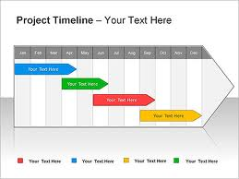
How? Project Timeline
It is difficult to predict the amount of time that it may take to advance a project from the concept to reality, as circumstances will inevitably vary from project to project.
At a minimum, the prospective project should expect to spend from six to twelve months assessing their state-specific political context, evaluating available incentives and business models, assembling a project team, identifying suitable project sites and selecting a solar developer.
This timeline, of course, can be delayed by complications with permitting. Once these initial steps are completed and project agreements are executed, construction and project commissioning can typically happen in less than six months, depending on the complexities involved with the site.

Slide 26
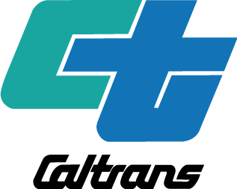
How? Gaining Agency Support and Structure for the Program
Confirm that the program concept is consistent with the overall goals and objectives of the agency and that other agency members have a clear understanding of how the proposed program is compatible with the agency’s mission.
Seeking authorization from agency and political leaders provides these decision-makers the opportunity to exercise their proper management and oversight functions.
Potential policy and planning frameworks that may validate agency support for a solar highway program include:
State transportation plan
Agency or state sustainability
Executive Orders on energy or sustainability
State climate action plans or greenhouse gas emissions reduction targets
Legislative mandates on renewable energy or sustainable economic development.
Identifying existing policy frameworks that explicitly justify pursuit of a program is important in providing the policy rationale and legal justification for the agency to act.

Slide 27
How?
The $1.2 billion Mid-Coast line would extend light rail eleven miles and include eight new stations by the time it is completed in 2016. Most of the corridor is shared with the Coaster diesel commuter rail line that extends from downtown San Diego to Oceanside, though the light rail would get its own right-0f-way through UCSD and its surroundings.
The Mid-Coast project would receive half its funds from the TransNet half-cent transportation sales tax reaffirmed by voters in 2004 and 50% from the federal government if Washington agrees.
TransNet is expected to raise a total of $14 billion in funds for transit and highway projects by the time it expires in 2048.

Slide 28

How? Leadership buy-in
Beyond the frontline Project Manager, it is critical to have the explicit and implicit support of agency leadership.
Securing the full backing of agency leadership is crucial. Without this endorsement it is easier for others to de-prioritize the project and discount the requests of the Project Manager.
With a stamp of approval the Project Manager will be able to hold others accountable, reconcile divergent opinions and points of view on trivial and inconsequential matters and call on top-level agency leadership when appropriate to keep the project on track.

Slide 29



How? Public Involvement and Communications
The project should include an Outreach Plan which includes:
A list of Target audiences and stakeholders
Adjacent property owners and neighbors
Impacted transportation users
Local officials and decision makers
Internal agency staff
Regional and local jurisdictional partners
Local businesses
Community civic organizations
Environmental interest groups
Project case statement
A description of the project and the agency’s motivation and an explanation of project benefits framed around community values and priorities
Planned outreach to target audiences
Engaging project advocates and critics

Slide 30
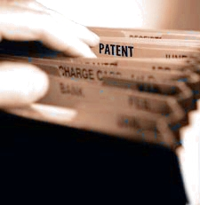
How? Intellectual Property
United States Patent 7,800,036: System and method for creating a networked infrastructure roadway distribution platform of solar energy gathering devices
Abstract
A roadway system for energy generation and distribution is presented. In accordance with one embodiment of the invention, the roadway system comprises a plurality of solar energy generating devices, and a roadway system electricity grid. The solar energy generating devices are electrically connected to the roadway system electricity grid and are positioned on part of or near to a road in a system of roads and being optionally fixed in a position such that a multi-form, solar energy gathering network can be formed.
Licensing
PGE purchased the sub-license in the ODOT roadside PV projects in order to proceed with ongoing project development. Though a non-disclosure agreement was signed as to the amount, the utility’s willingness to do so implies it was likely not too cost prohibitive.
Inventors: Fein; Gene S., Merritt; Edward (Lenox, MA)
Assignee: Genedics Clean Energy, LLC (Pittsfield, MA)
Appl. No.: 12/321,587
Filed: January 21, 2009
www.thegreenroadway.com

Slide 31
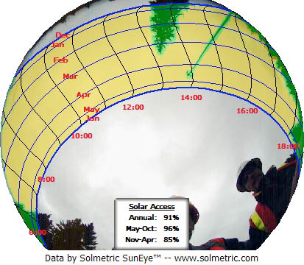
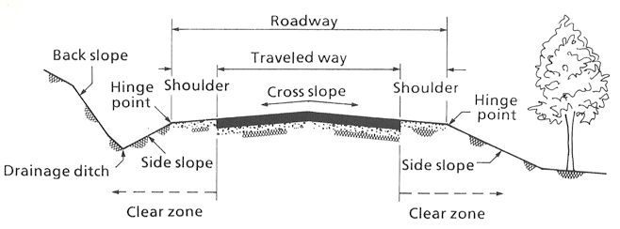
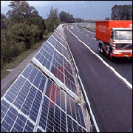
Progress for Local Applications
UCSD engineering students are conducting an independent study project for preliminary feasibility research and concept art?
Objective:
Phase 1
1A: Preliminary feasibility study and concept art for a PV system sited on 5 of the 11 mile La Jolla trolley-line expansion.
1B: Preliminary feasibility study and concept art for a PV system sited on an additional 20 miles of existing trolley-line.
Phase 2
Preliminary feasibility study and concept art for a PV system sited on 50 miles of San Diego’s highways (walls, medians and right-of-ways)
https://sites.google.com/site/rsdmae199/home

