Slide 1
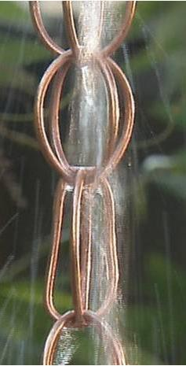



Water Conservation & Reuse Strategies for Southern California
Rosalind Haselbeck & Rich Alianelli Building Green Futures Inc. September 23, 2010 (619) 300-7114

Slide 2
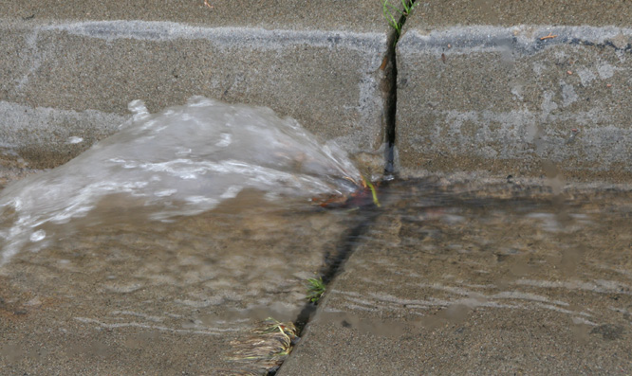
Notes:
Rainwater harvesting is the practice of collecting the water produced
during rainfall events before it has a chance to run off into a river or stream or
soak into the ground and become groundwater. Stormwater is water that accumulates on land as a result of storms, and can include runoff from urban areas such as roads and roofs; runoff decreases amt water percolating into land and restoring aquifers—increases volume/decreases quality of surface water

Slide 3
Stormwater
According to the EPA, non-point source pollution(from stormwater runoff) is the leading remaining cause of water quality problems
Source: http://water.epa.gov/polwaste/nps/whatis.cfm

Slide 4
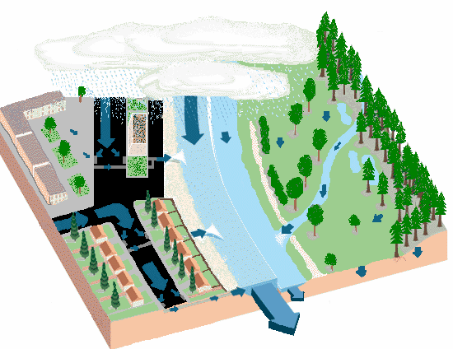
Water Run-off: developed vs. natural
Source: http://www.coastal.ca.gov/nps/watercyclefacts.pdf
Notes:
When precipitation falls over the land, it follows various routes. Some of it
evaporates, returning to the atmosphere, some seeps into the ground, and the remainder
becomes surface water, traveling to oceans and lakes by way of rivers and streams.
Impervious surfaces associated with urbanization alter the natural amount of water that
takes each route. The consequences of this change are a decrease in the volume of
water that percolates into the ground, and a resulting increase in volume and decrease in
quality of surface water. These hydrological changes have significant implications for the
quantity of fresh, clean water that is available for use by humans, fish and wildlife

Slide 5
Water Usage
Location | Water use GPC/day
San Diego | 164
US average | 152
Japan | 99
Germany | 51
Nigeria | 10
Uganda | 4
Water scarcity | <13
Source: SDWA Annual Report 2009
Notes:
SD urban water use down from 178 gpc/d 2008

Slide 6
Source: American Waterworks Association Research Foundation (AWWARF) Residential End Uses of Water, Denver, CO; 1999

Slide 7
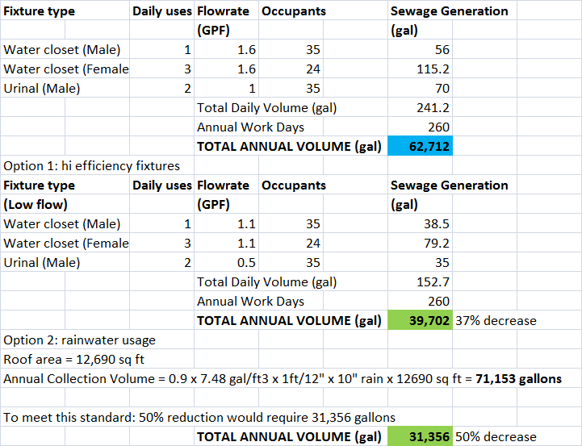
Example Commercial Building Indoor Rainwater Application

Slide 8
Benefits of Rainwater Harvesting
COMMUNITY
Storm water management (reduces run off to storm drains)
Reduces summer peak water demands (conserves water)
INDIVIDUAL
Superior water for irrigation (soft, non-alkaline)
Lower water bills (1st tier)
Possible rebates/incentives (AB 1834)
Notes:
There are numerous potential benefits and advantages from rainwater harvesting
(Krishna, 2003). Rainwater harvesting systems can
• provide a source of free water—the only costs would be for storage,
treatment and use;
• provide water if there is no other source of water;
• augment or replace limited quantities of groundwater;
• provide good-quality water if groundwater quality is unacceptable;
• provide water if tap charges are too high for water supply connection;
• reduce storm water runoff;
• reduce non-point source pollution;
• reduce erosion in urban environments;
• provide water that is naturally soft (no need for water softeners);
• provide water that is pH neutral/slightly acidic;
7
• provide water that is sodium-free, important for those on low-sodium diets;
• provide good quality water for landscape irrigation;
• provide water for non-potable indoor uses;
• provide safe water for human consumption, after appropriate treatment;
• help utilities in reducing peak demands in the summer;
• help utilities in delaying the expansion of water treatment plants;
• provide water for cooling and air-conditioning plants;
• reduce the demands on groundwater;
• provide water for fire protection; and
• save money for the consumer in utility bills.
Rainwater harvesting also provides several additional benefits. It can reduce
scaling build-up in hot water heaters, plumbing, faucets, and showerheads.
Rainwater requires less soap and detergent than most public water supplies
because of its natural softness. In particular, use of rainwater can be valuable
for the hotel industry, helping them reduce their use of municipal water
supplies and the amount of detergents used for their daily laundry. Krishna, Hari J., 2003, An overview of rainwater harvesting systems and
guidelines in the United States, Paper presented at the First American Rainwater
Harvesting Conference, Austin, TX.
Assuming a statewide average precipitation of 28 inches per year, the Texas
Rainwater Harvesting Evaluation Committee determined that capturing rainfall on
10 percent of the total roof area in the state over the course of one year would
generate approximately 120,000 acre-feet of water. The committee compared
this value to the 396 million acre-feet of water resulting from the 28 inches of
rainfall over the entire state and found that the rainfall intercepted by rainwater
harvesting amounted to only 0.03 percent of the statewide rainfall total.

Slide 9


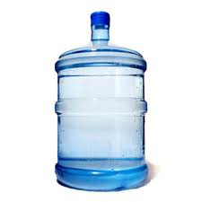
1” of rain on a 1,000 sq ft roof
1 inch of rain from
a 1,000 sq ft roof
=
600 gallons
of water
=
With 10 inches of rain in San Diego, this adds up to
> 12,000 gallons per year for a typical 2,000 sq ft home!

Slide 10
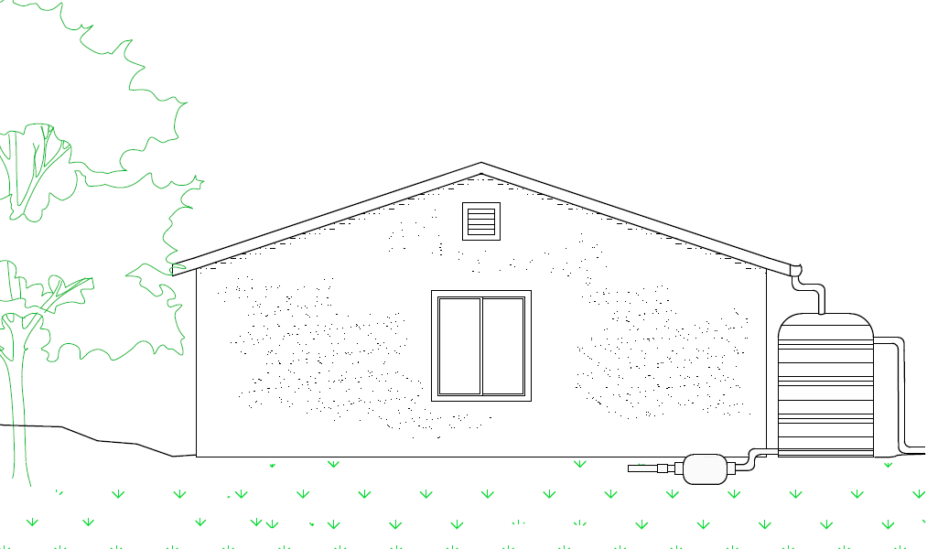
Components of Rainwater Harvesting for Irrigation
Roof catchment area
Gutters & downspout
Storage
Tank
To drip system/hose
Overflow
Pump
Source: Building Green Futures (www.buildinggreenfutures.com)

Slide 11
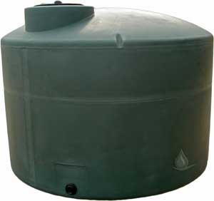
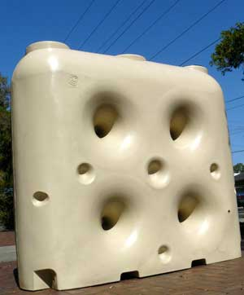
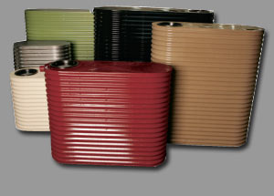
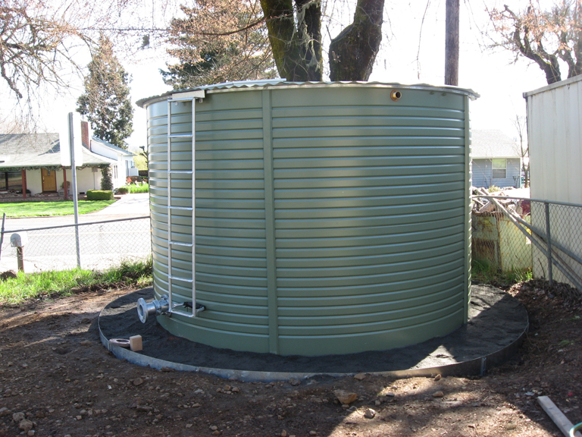
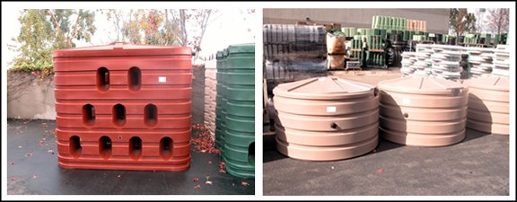
Above-ground Tanks
Source: RainHarvest Systems
Source: Tankworks Australia
Source: BH Tanks Inc.
Source: Bushman Tanks USA

Slide 12
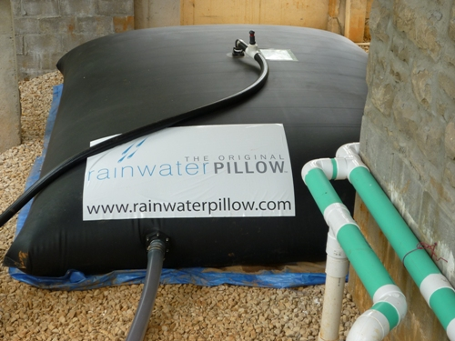
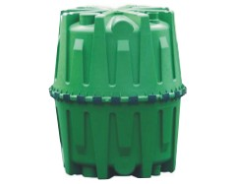
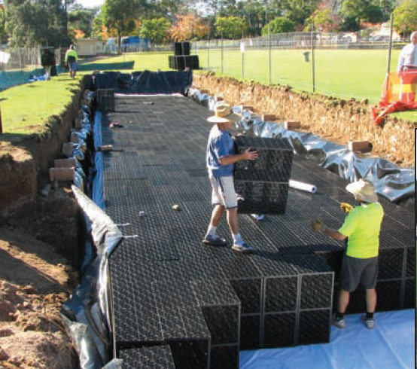

Below-ground Tanks
Source: Graf Rainwater Tanks
Source: Rainwater Collection Solutions
Source: Xerxes Fiberglass Tanks
Source: Atlantis Water Management
Notes:
Recycled plastic = atlantis; graf proprietary pe

Slide 13
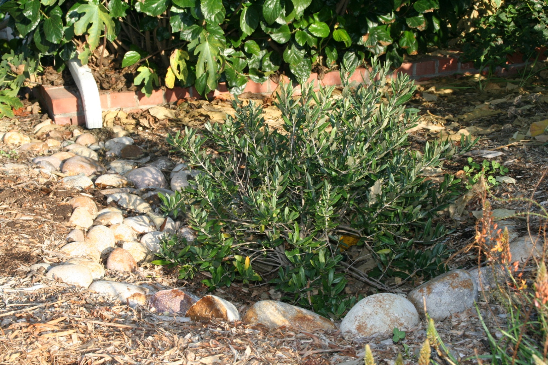
Using Earthworks
Source: Building Green Futures (www.buildinggreenfutures.com)

Slide 14
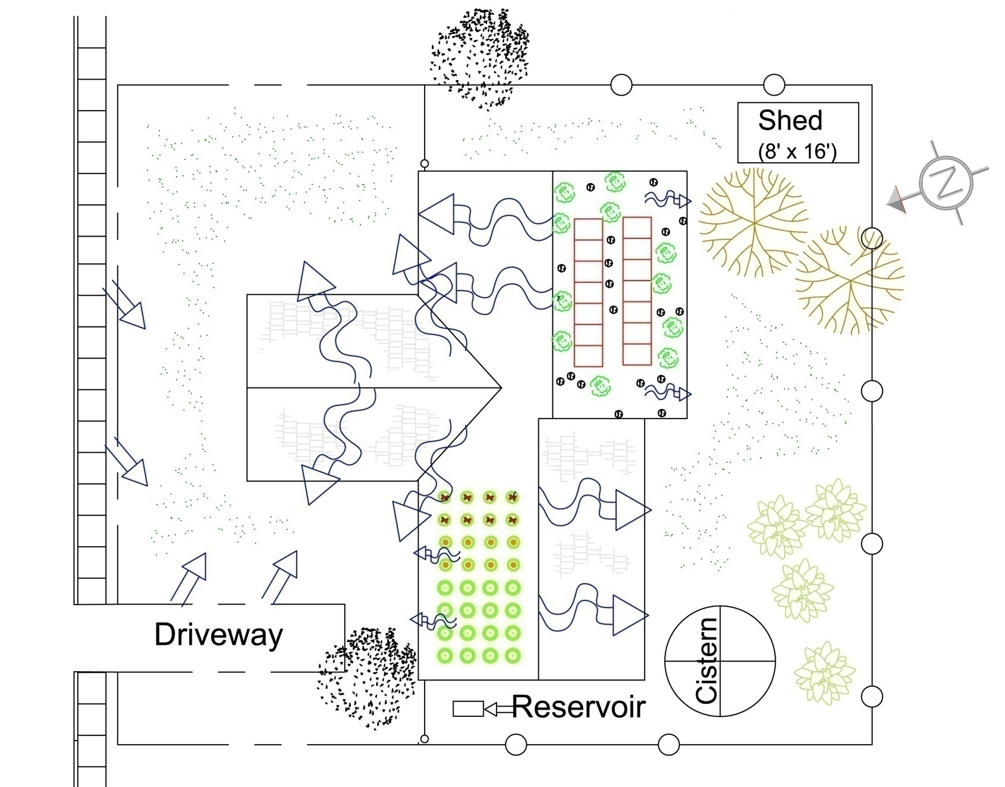
Sustainable Water Management
Source: Building Green Futures (www.buildinggreenfutures.com)

Slide 15
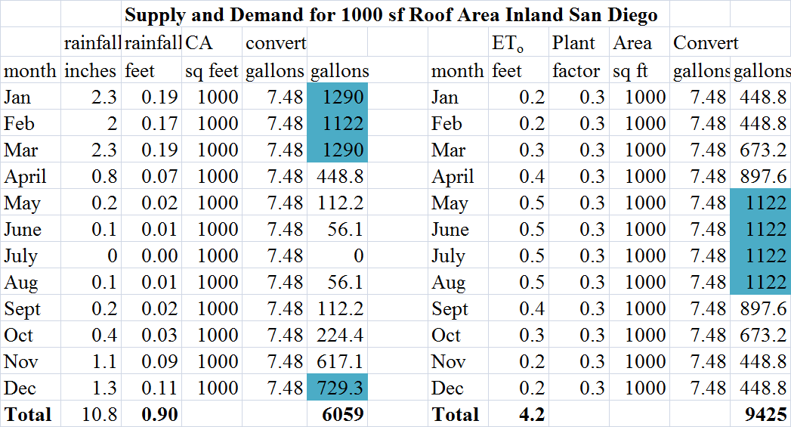
Estimating Supply & Demand
Source: Building Green Futures (www.buildinggreenfutures.com)
Notes:
Over 70% of our rain typically between Dec through March while evapotranspiration rates highest in dry months because evaporation increases with dryness and heat, and photosynthesis higher with more sun—luckily can store the raiwater until needed—used plant factor 0.3 for drought-tolerant—note demand is higher but rainfall not taken into account

Slide 16
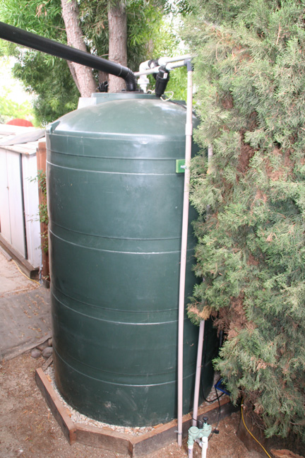
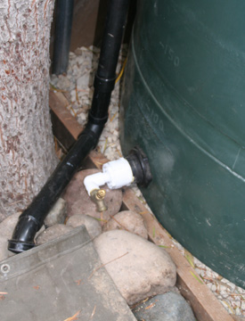
Project 1: An Above- ground System with a
550 gallon tank
Source: Building Green Futures (www.buildinggreenfutures.com)

Slide 17
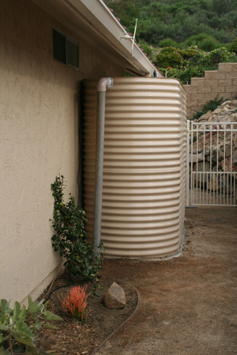
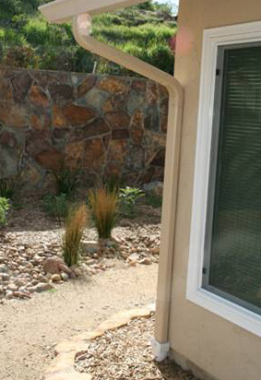
Project 2: An Above-ground System with (2) 2,000 gallon tanks and French drains to landscape
Source: Building Green Futures (www.buildinggreenfutures.com)

Slide 18
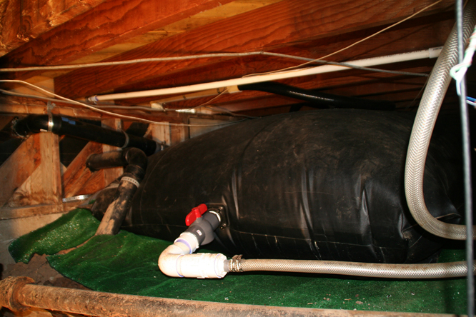
Project 3: a Rainwater Pillow
Source: Building Green Futures (www.buildinggreenfutures.com)

Slide 19
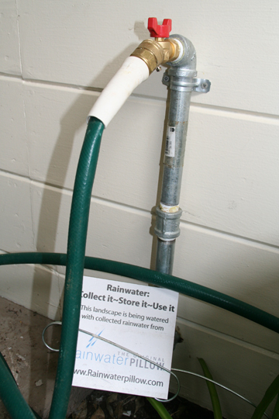
Source: Building Green Futures (www.buildinggreenfutures.com)

Slide 20
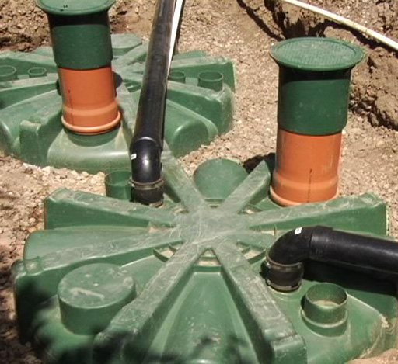
Project 4: A Modular Underground Storage System
Source: Building Green Futures (www.buildinggreenfutures.com)

Slide 21
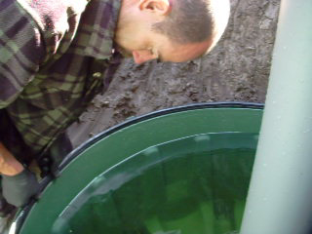
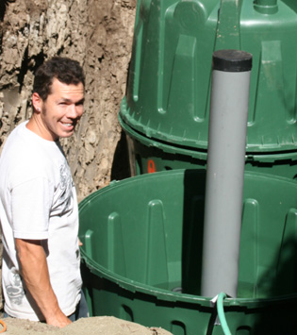
Source: Building Green Futures (www.buildinggreenfutures.com)

Slide 22
Resources
http://www.sandiego.gov/water/conservation
Rainwater harvesting information; residential water surveys (free)
http://www.bewaterwise.com ; Rebates and incentives (So Cal Metropolitan Water District)
http://socalwatersmart.com/index.php; Rebates/incentives
http://www.harvesth2o.com/ ; Online rainwater harvesting community
http://www.arcsa.org/Rainwater-10-09.pdf; Rainwater Catchment Standards ARCSA and ASPE

Slide 23

Resources; continued
http://www.epa.gov/npdes/pubs/gi_munichandbook_harvesting.pdf; EPA Rainwater Harvesting Guidelines
http://www.whollyh2o.org; California’s Integrated Water Reuse Management Center
http://www.h2ouse.org; California’s Urban Water Conservation Council
http://www.oasisdesign.net/greywater/law/california/; California Graywater Policy Center
Rainwater Harvesting for Drylands vol 1-3 by Brad Lancaster, Rainsource Press (2005-2011)

