Slide 1
Resilient Agriculture and Food System
July 24 2014
Presented by: Camille Castillo, Won Mo Yang,
Erin Johnson, and Abraham Pinheiro
1

Slide 2
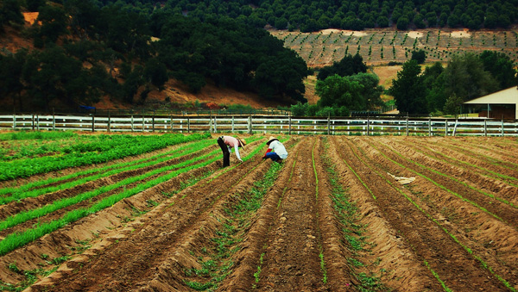
Outline
Food and Agriculture Statistics on a Global, National, and City level
Climate Change Risks in California
Food Economics and Safety
Food Security
Photo Credit: The California Report
2

Slide 3
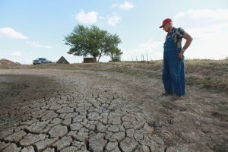
“The California Farm Water Coalition estimates that as many as 800,000 acres in the state won’t have water to sprout seeds or irrigate trees and will be idled. While consumers may moan about increased prices for the produce they have come to assume is always there, the real loss will come in the form of farm failures and unemployment.”
- Eric Larson Executive Director of San Diego County Farm Bureau
Photo Credit: KPBS San Diego
3

Slide 4
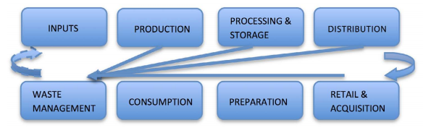
What is a food system?
“It describes the entire set of processes involved in the production and consumption of food.”
- UC Sustainable Agriculture Research and Education Program (UC SAREP), UC Davis Agriculture Sustainability Institute “Assessing the San Diego County Food System”
Food system flow diagram.
Source:
UC SAREP
A resilient food system is:
Diverse
Distributed
Natural
Innovative
Inclusive
Source: ICLEI
4
Notes:
Diverse: enhance biodiversity, seed systems, ecosystem services & incorporate urban agriculture
Distributed: growing produce in various locations in and around the city
Natural: growing agriculture that takes climate & biodiversity needs into consideration. Contributes to better management of natural resources
Innovative: tech design and creativity to reduce waste, recycle nutrients, restore landscapes
Inclusive: private (producers, transporters, processors), public (local/central gov) and citizens are involved with creating a better food system
Source:
http://sarep.ucdavis.edu/sfs/files/SD%20Foodshed%20Assessment%20Final.pdf
http://resilient-cities.iclei.org/bonn2013/program/urban-food-systems-forum/resilient-urban-food-systems-in-brief/

Slide 5
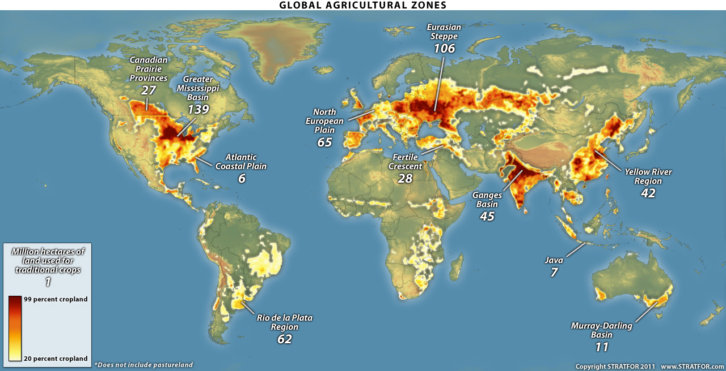
Humans occupy 40% of land in the world…
But most of that is used for
agriculture
Million hectares of land used for traditional crops
1
Source: STRATFOR Global Intelligence
5
Notes:
- Darker red shows more % of land is used for traditional crops
Majority of hectares used for traditional crops is in U.S. with 139 hectares while Europe, India, and East Asia follow
Or use crops and pastureland used map from 2005? http://www.ourworldindata.org/data/food-agriculture/land-use-in-agriculture/
Crop growing land area in the whole word = size of South America
All the pastureland (land to raise animals) = size of Africa
Source: science museum of minnesota

Slide 6
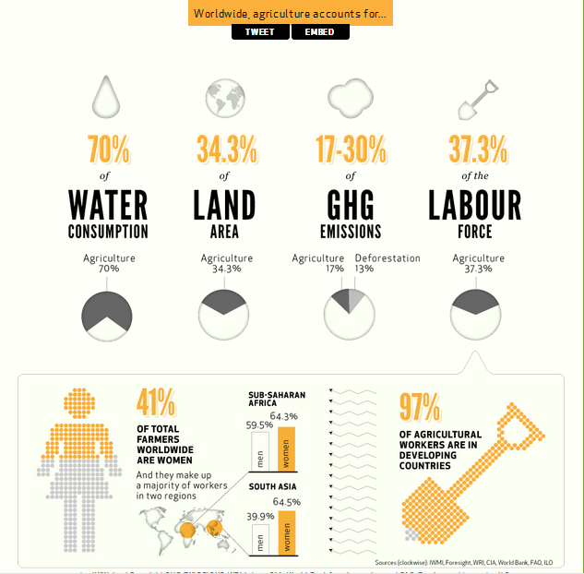
Global facts
Agriculture accounts for 2% of total world energy used
Poultry birds accounts for over 80% of all livestock
Source: Food and Agriculture Organization of the UN (FAO)
Source: Farming First
A big portion of CO₂ emissions comes from agriculture
6
Notes:
Many components that need to be considered within agriculture (and livestock) including (but not limited to):
Food costs, energy, land area, emissions, labour
3500 km³ of water needed?

Slide 7

Farmers everywhere will need to produce more food and other agricultural products on less land, with fewer pesticides and fertilizers, less water and lower outputs of greenhouse gases.
- Professor Gordon Conway
Imperial College London, UK
7

Slide 8
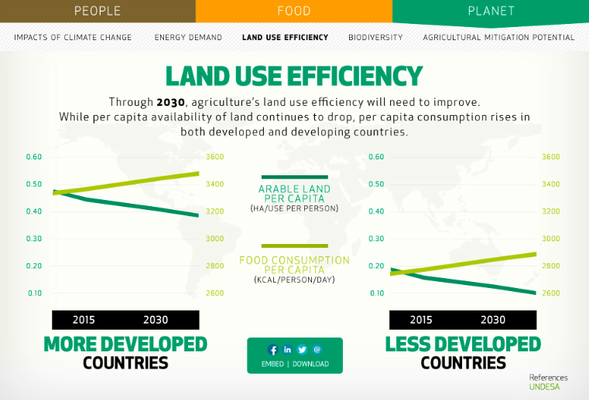
Global issues
Malnutrition
Food security
Quality land and water shortage
Rising food, energy, and fertilizer prices
Source: Farming First
8
Notes:
Graph shows food consumption is expected to go up by 2030 while amount of arable land will decrease in both developed and less develop countries

Slide 9
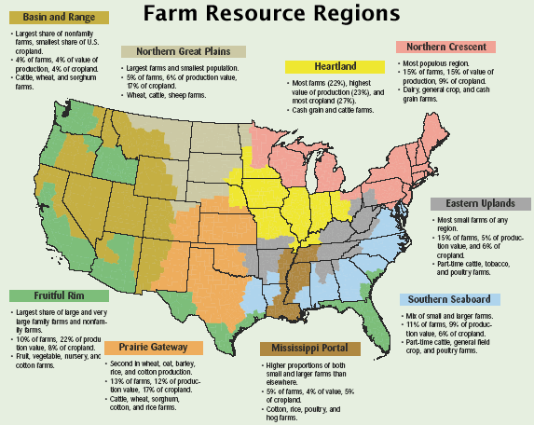
U.S. Agriculture: What is grown where?
Northern Great Plains:
Wheat, cattle
Heartland: Cash Grain, cattle
West: Fruit, vegetables, nursery
Northern Crescent: Dairy, cash grain
Southern Seaboard: Poultry, general crop
Prairie: Wheat, cotton, rice
Source: US Department of Agriculture(USDA)
9

Slide 10
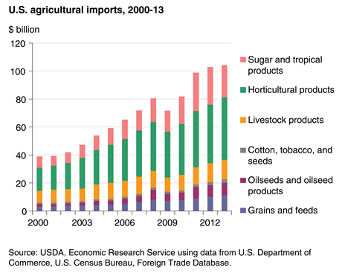
Imports: Where do we get our food?
What food do we import?
Import mostly from Canada and Mexico
1/5 of food consumed
  is imported
U.S. imports:
  13% of grains,
  20% of vegetables,
  40% of fruit,
  85% of shellfish and
  almost all tropical products (coffee, tea, bananas)
Source: National Climate Assessment US Global Change Research Program
10

Slide 11
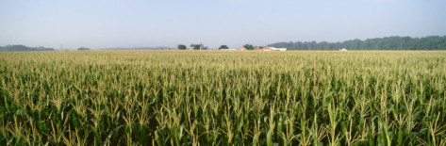
U.S. farmers are very productive
Major agricultural crops produced in U.S. 2011
(Excluding root crops, citrus, vegetables, etc.)
Crop | Harvested Area (million acres) | Cash Receipts from Sales ($ billions)
Corn (Grains) | 84 | 63.9
Soybeans | 73.8 | 37.6
Hay | 55.7 | 6.7
Wheat | 45.7 | 14.6
Cotton | 9.5 | 8.3
Sorghum (grain) | 3.9 | 1.3
Rice | 2.6 | 2.9
#1 producer of corn (32% of world supply, export 20% of it)
U.S. produces
  $330 billion per year in agricultural commodities
Source: USDA National Agricultural Statistics Service
11
Notes:
Foods w/ highest share of domestic production include poultry meat and eggs, milk and other dairy products, and bulk grains
Source: usda economic research service

Slide 12
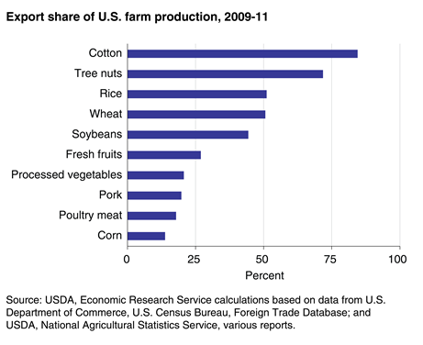
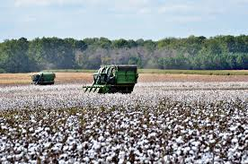
U.S. is the top exporter of food
Followed by Canada
then Brazil
Cotton is our #1 export
Cotton field in Chula, Georgia
12

Slide 13
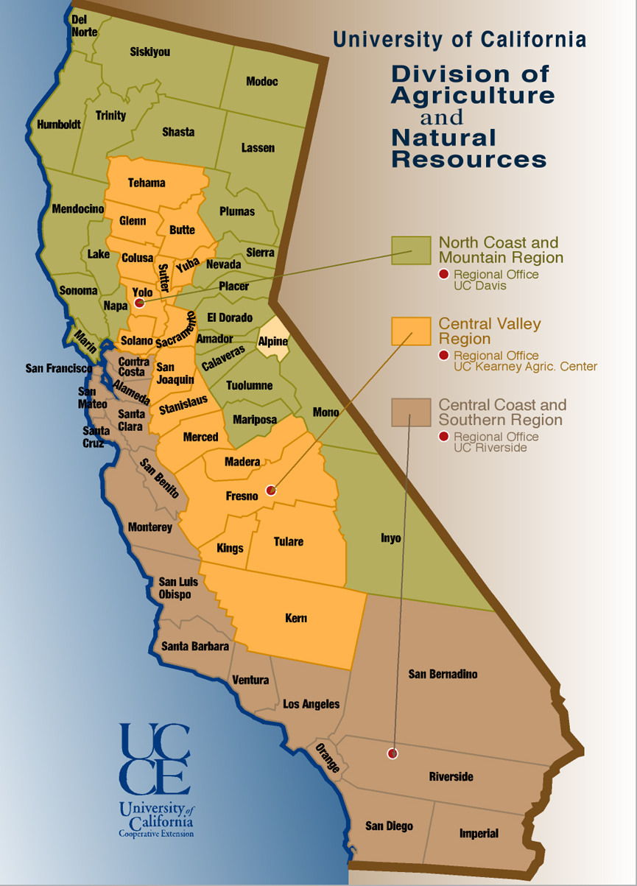
California Agriculture
Top 5 commodities in 2012:
Milk – $6.9 billion
Grapes - $4.45 billion
Almonds - $4.35 billion
Nursery plants - $3.5 billion
Cattle, calves - $3.3 billion
Map of California’s agricultural counties.
Source: California Department of Food and Agriculture
13
Notes:
CA leads the nation in selling (and sole producer):
Almonds, artichokes, dates, figs, grapes/raisins, kiwifruit, olives, peaches, pistachios, dried plums, pomengranates, walnuts
Source: CA agricultural statistics review 2013-2014

Slide 14
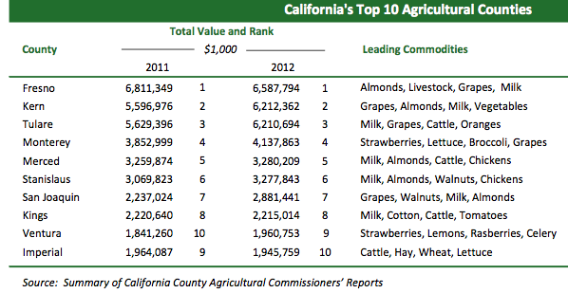
California’s Top 10 Agricultural Counties
San Diego was ranked #11 in 2012
Leading commodities: ornamental nursery plants, avocados, tomatoes, and lemons
14

Slide 15
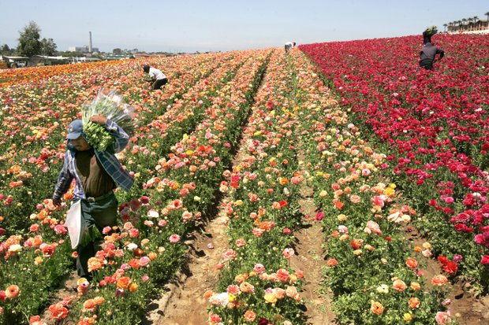
San Diego County
Agriculture
Nationally ranked:
#1 Nursery production
#1 Avocado production
#1 number of Small Farms
#1 number of Organic Farms
Source: Eric Larson, San Diego County Farm Bureau
19th largest agricultural economy in U.S.
Total agriculture value $1.75 billion/year
Covers 303,983 acres 11.3% of total acres in
the county
6,687 farms
68% of farms are
1-9 acres
Source: San Diego County Department of Agriculture, Weights, and Measurements (SDAWM)
Source: UT San Diego
15
Notes:
http://www.sdcounty.ca.gov/reusable_components/images/awm/Docs/2012_Crop_Report.pdf

Slide 16
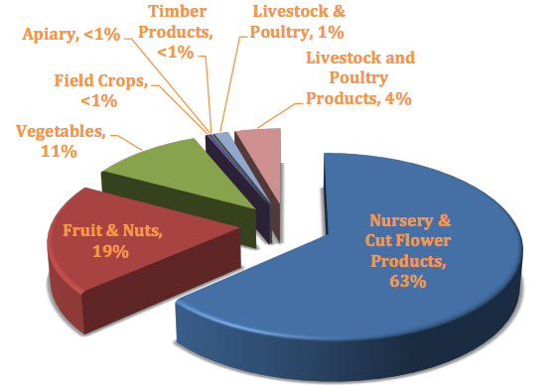
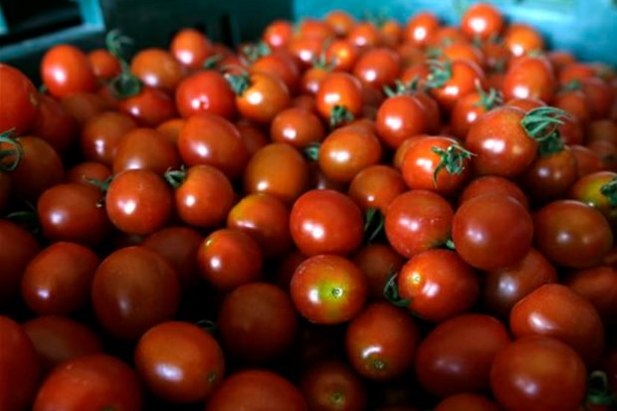
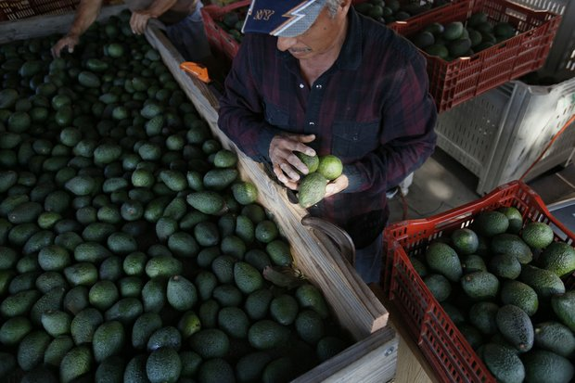
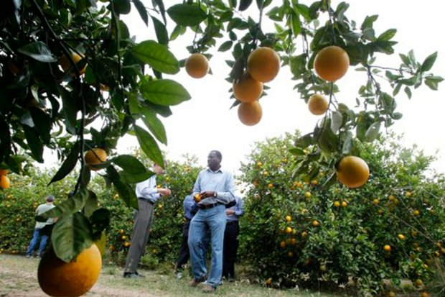
San Diego Crop Profile
Top 5 Food Crops
Avocados $158 million
Citrus $117 million
Tomatoes $92 million
Eggs $54 million
Strawberries $23 million
Nursery Cut Flower Products
63%
Fruit & Nuts
19%
Source: SDAWM
Source: UT San Diego
16
Notes:
Source: Karen Melvin presentation, SD dept of ag, weights, and measurements
Source for pics:http://www.utsandiego.com/news/2013/Sep/11/top-crops-san-diego-avocadoes-lemons-hp/#&panel2-1

Slide 17
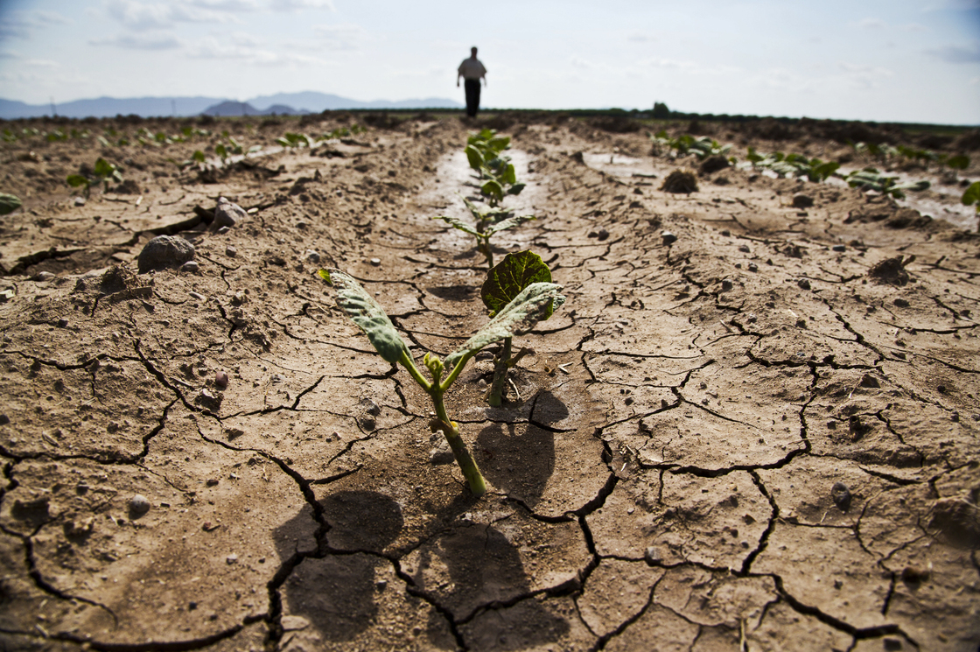
Climate Change
Risks in California
17

Slide 18
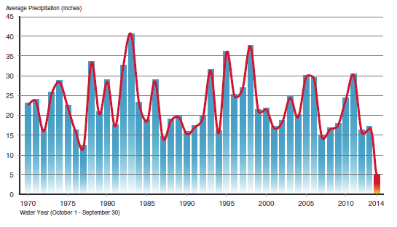
Average Precipitation in California
Source: California Department of Water Resource
This year is the worst drought condition in 119 years.
18

Slide 19
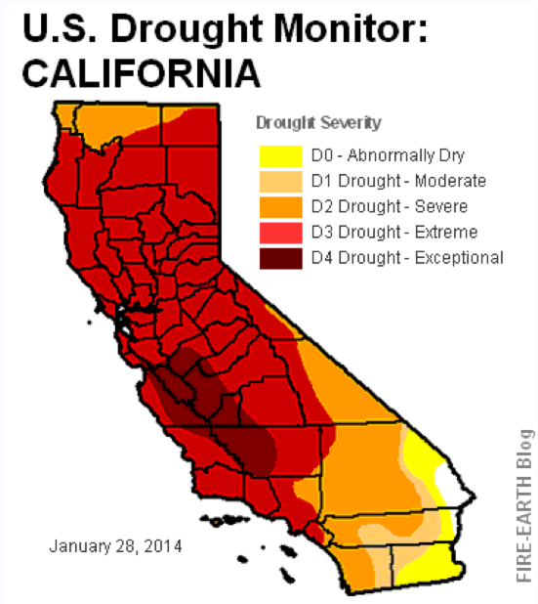
Drought in California
“Nearly 80% of California now under 'extreme' drought conditions”
  LA TIMES
19

Slide 20
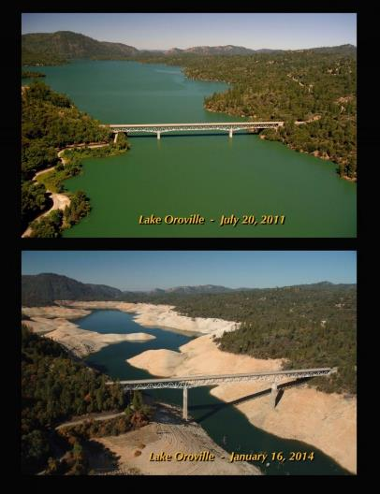
Effect of Drought in California
While water demand is increasing, climate change could potentially shrink water supplies
Rainfall in San Diego has decreased over the last 5 years, while experiencing serious droughts.
Lake Oroville – July 2011
Source: California Department of Water Resource
Lake Oroville – January 16,2014
20

Slide 21
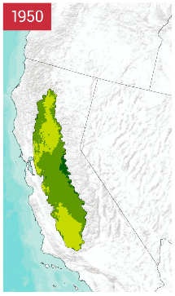
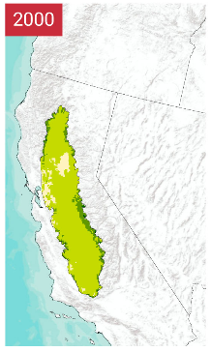
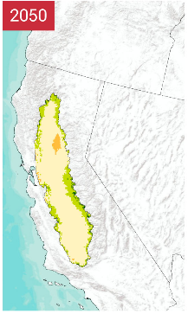
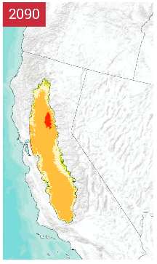
Reduced Winter Chilling Projected for California
Source: U.S. Global change Research Program
Chill hours are roughly the number of hours between the temperatures of 32-45 degrees Fahrenheit. Winter hours above 60 degrees are subtracted from the totals. The idea is that a deciduous plant goes dormant in the cold winter to protect itself from the cold
21
Notes:
Many perennial plants (such as fruit trees and grape vines) require exposure to particular numbers of chilling hours (hours in which the temperatures are between 32°F and 50°F over the winter). This number varies among species, and many trees require chilling hours before flowering and fruit production can occur. With rising temperatures, chilling hours will be reduced. One example of this change is shown here for California’s Central Valley, assuming that observed climate trends in that area continue through 2050 and 2090. Under such a scenario, a rapid decrease in the number of chilling hours is projected to occur.
By 2000, the number of chilling hours in some regions was 30% lower than in 1950. Based on the A2 emissions scenario that assumes continued increases in heat-trapping gases relative to 1950, the number of chilling hours is projected to decline by 30% to 60% by 2050 and by up to 80% by 2100. These are very conservative estimates of the reductions in chilling hours because climate models project not just simple continuations of observed trends (as assumed here), but temperature trends rising at an increasing rate. To adapt to these kinds of changes, trees with a lower chilling requirement would have to be planted and reach productive age.
Various trees and grape vines differ in their chilling requirements, with grapes requiring 90 hours, peaches 225, apples 400, and cherries more than 1,000. Increasing temperatures are likely to shift grape production for premium wines to different regions, but with a higher risk of extremely hot conditions that are detrimental to such varieties. The area capable of consistently producing grapes required for the highest-quality wines is projected to decline by more than 50% by late this century. (Figure source: adapted from Luedeling et al. 2009).

Slide 22
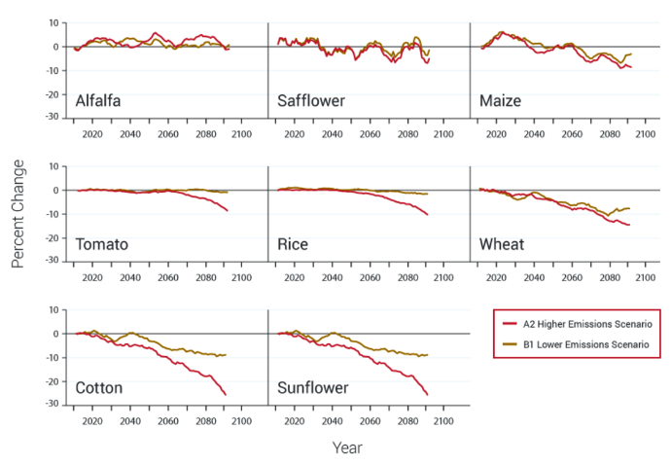
Crop Yield Projection to Warming in California's Central Valley
Period from 2010 to 2090
Changes in climate through this century will affect crops differently because individual species respond differently to warming
Source: U.S. Global change Research Program
22
Notes:
Changes in climate through this century will affect crops differently because individual species respond differently to warming. This figure is an example of the potential impacts on different crops within the same geographic region. Crop yield responses for eight crops in the Central Valley of California are projected under two emissions scenarios, one in which heat-trapping gas emissions are substantially reduced (B1) and another in which these emissions continue to grow (A2). This analysis assumes adequate water supplies (soil moisture) and nutrients are maintained while temperatures increase. The lines show five-year moving averages for the period from 2010 to 2094, with the yield changes shown as differences from the year 2009. Yield response varies among crops, with cotton, maize, wheat, and sunflower showing yield declines early in the period. Alfalfa and safflower showed no yield declines during the period. Rice and tomato do not show a yield response until the latter half of the period, with the higher emissions scenario resulting in a larger yield response. (Figure source: adapted from Lee et al. 2011).

Slide 23
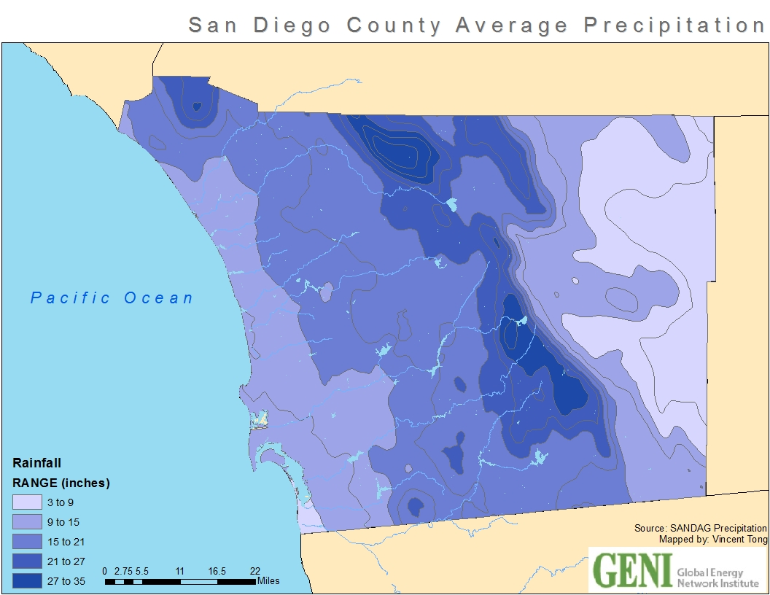
San Diego County Average Precipitation
Lighter areas of the map are experiencing limited rainfall range
23

Slide 24
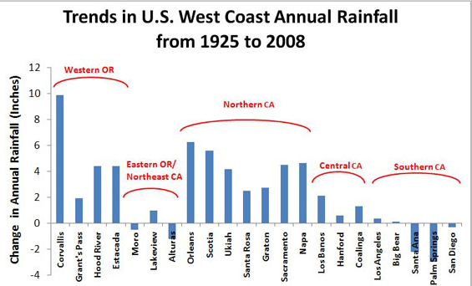
San Diego’s Limited Rainfall
Source: NASA
Southern California is suffering from limited rainfall
24

Slide 25
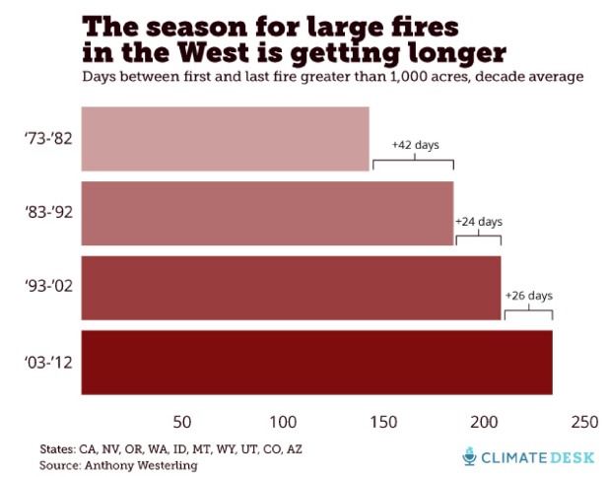
Wildfire in California
In the last four decades, wildfire season in the west has gotten three month longer
25

Slide 26
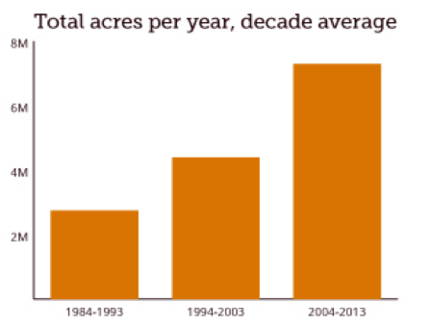
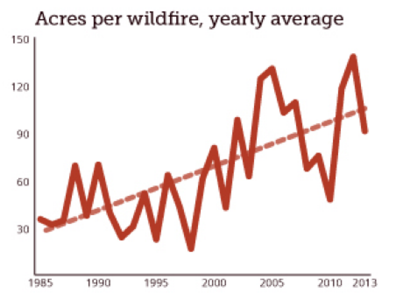
Wildfire effect on agricultural in the California
The most acres burned in the past twenty years:
9.8 million acres burned in 2006
26

Slide 27
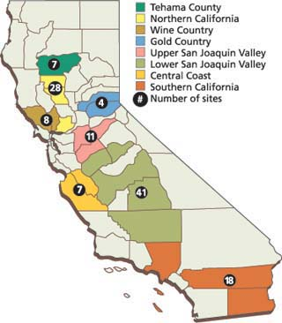
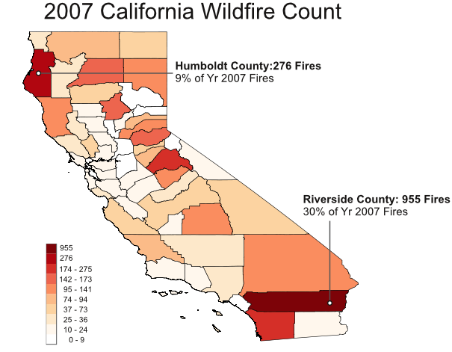
Risk of Wildfire in Agricultural Regions
Figure on the left shows where wildfires occurred in 2007 compared to figure on the right where our agricultural is at risk.
Source: University of California
Source: Bureau of Land Management
27

Slide 28
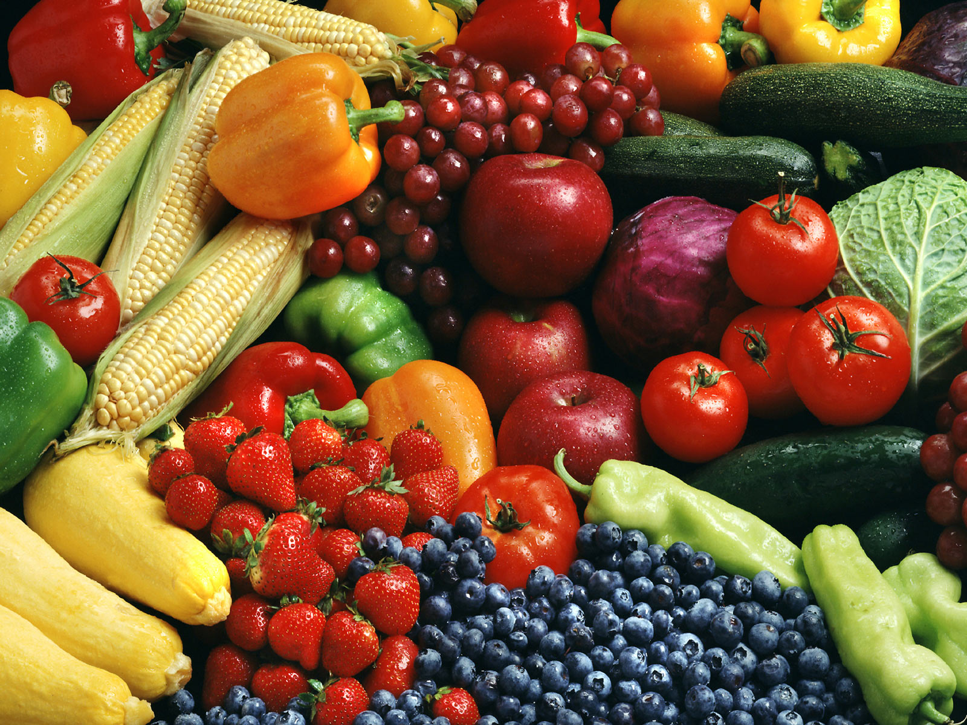
Food Economics and Safety
Source: Roma Foods Importing Company, INC
28

Slide 29
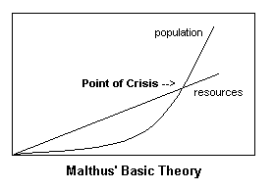
Thomas Malthus: Theory of Population
Thomas Malthus proposed in Essay on the Principle of Population that while the human population grows exponentially, food production grows at a linear rate.
Source: AAG Center for Global Geography Education
Cla.calpoly.edu
29

Slide 30
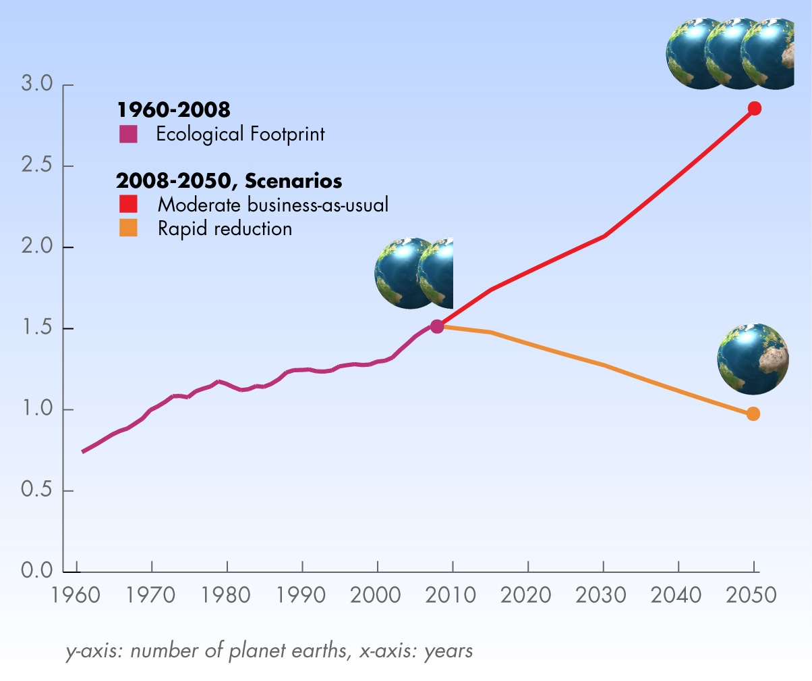
Rapid Resource Consumption
Due to the rapid growth of the human population, there will be a greater demand of resources that could result in a shortage during our generation.
If we continue to consume at our current rate, we could eventually reach a point of crisis.
Source: Global Footprint Network
30

Slide 31
Food Definitions
Genetically Modified Organism (GMO):
An organism or microorganism whose genetic material has been altered by means of genetic engineering.
Source: Dictionary.com
Natural: Food that does not contain added color, artificial flavors, or synthetic substances.
Source: FDA
Organic: food produced from a farming system, which avoids the use of man-made fertilizers, pesticides, growth regulators and livestock feed additives.
Source: EUFIC
Conventional: Produce that is grown conventionally might be sprayed with certain pesticides, fungicides or herbicides as it grows.
Source: nutrition.answers.com
31

Slide 32
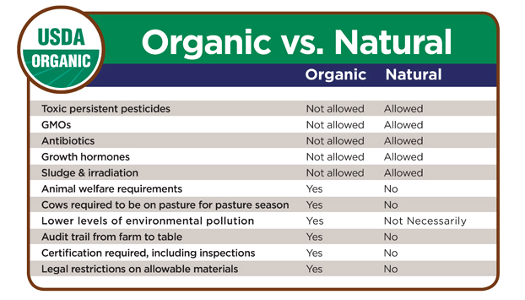
Organic benefits Vs. Natural
Source:USDA
32

Slide 33
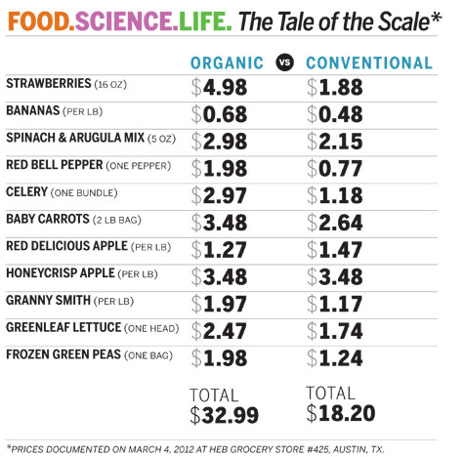
Organic vs. Conventional: Price Discrepancy at the store
Unless Organic food prices begin to resemble the prices of conventional items,
consumers will choose the cheaper option even if it has negative externalities.
Source: U Texas
33

Slide 34
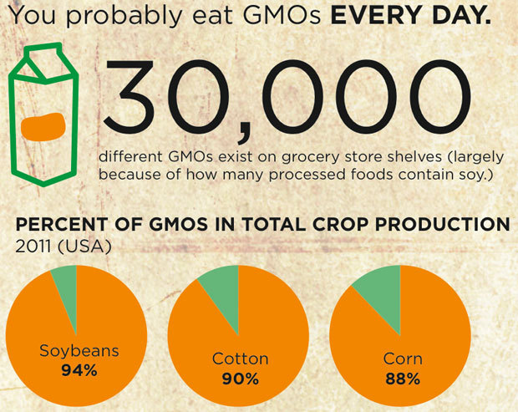
GMO Consumption
Source: John F. Reed Library
34

Slide 35
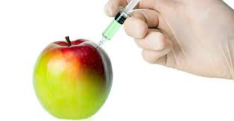
Using GMOs
Pros:
Crops are designed to be disease, drought and insect resistant
Produce larger and more attractive produce
Add nutrients to common foods for more value
Reduce allergies for crops
Create higher crop yields to feed more people
Requires less tilling to remove weeds, improving the quality of the soil
Source: classes.soe.ucsc.edu Source: newportnaturalhealth.com
Photo: Olive Oil Times
35

Slide 36
Using GMOs
Cons:
Increases the use of pesticides and herbicides
Cross pollination that can infect other plants leading to the creation of superweeds that are herbicide or insecticide resistant such as glyphosphate, a common GMO herbicide.
A human population that is consuming an insecticide, a bacterial toxin called Bacillus Thuringiensis (BT) by eating the GMOs that contain them
Disappointing crop yields and doubt over the environmental benefits of reduced tilling
Source: classes.soe.ucsb.edu
Source: newportnaturalhealth.com
36

Slide 37

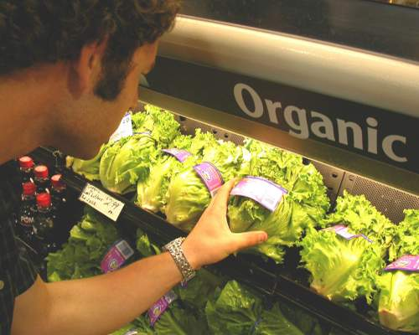
Pros:
25% of Americans choose organic food each week.
They are free of synthetic chemical hormones and pesticides.
They are grown naturally and have no artificial flavoring.
Source: classes.soe.ucsb.edu Source: newportnaturalhealth.com
37

Slide 38
Cons:
Smaller crop yields compared to GMOs
More costly
- organic farmers do not receive federal subsidies
-organic farming requires more oversight and is more labor intensive
-organic farms are smaller and do not enjoy benefits from economies of scale
- higher possibility of produce damage from lack of pesticide use.
Source: classes.soe.ucsb.edu Source:newportnaturalhealth.com
38

Slide 39
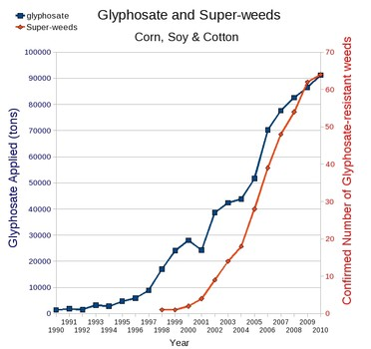
Pesticides
Most Common Pesticide used for GMOs:
-Monsanto’s Roundup herbicide (made of glyphosphate)
39

Slide 40
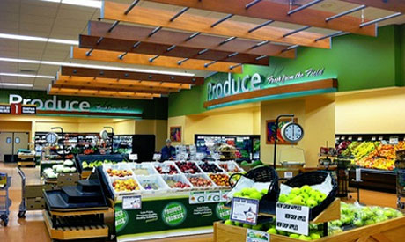
Where to go in San Diego for GMO free products?
Jimbo’s Naturally
Ocean Beach People’s Organic Food Co-Op
Local Habit
Hagoo’s Organic Taco
Harvest
Source: Non GMO and Organic Restaurants
Source: Naturally Savvy Natural and Organic Living
40

Slide 41
Food Security
“Food Security exists when all people, at all times, have physical, social and economic access to sufficient, safe and nutritious food that meets their dietary needs and food preferences for an active and healthy life”
Source: Food and Agriculture Organization of the UN
“With world population that is projected to reach 9 billion by 2050, require 70 percent more food than we produce today, and a growing global middle class that is consuming more meat and dairy”, food security is crucial.
Source: The Earth Institute Blog, Columbia University
41

Slide 42
Food Security
Daily Average Calorie Intake Per Capita
Source: Chartsbin
42

Slide 43
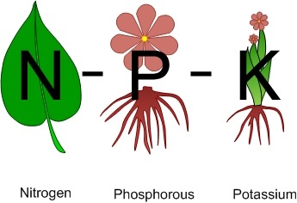
Fertilizers
“Improved irrigation and more intelligent use of fertilizers could increase agricultural production by as much as 70%.”
Source: nature.com Virginia Gewin
Nitrogen
Phosphorous
Potassium
43

Slide 44
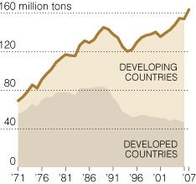
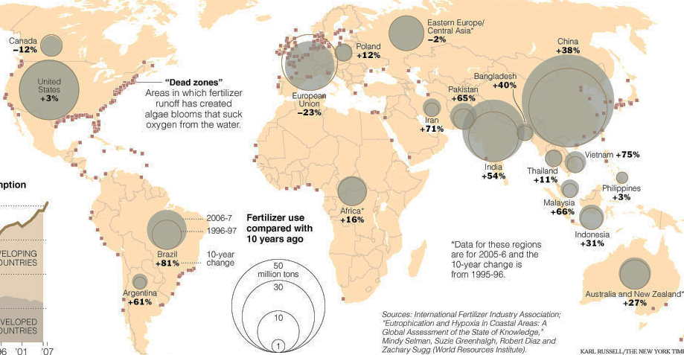
Worldwide Fertilizer Growth
44

Slide 45
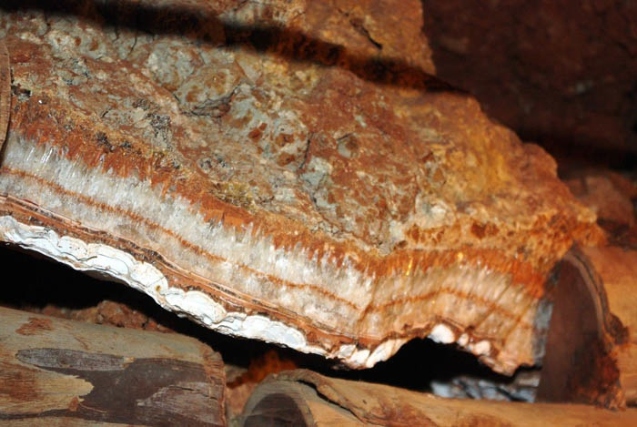
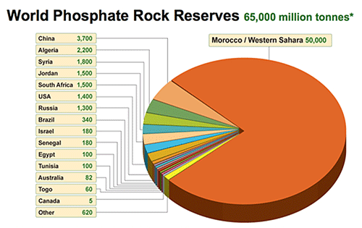
Peak Phosphorous
Is a renewable resource
Most of the phosphorus used in fertilizer comes from Phosphate Rock.
The U.S. has 25 years of phosphate rock reserves left and imports phosphate rock from Morocco.
As the quality of phosphate rock reserves declines, more energy is necessary to mine it. The processing of lower grade phosphate rock produces more heavy metals such as cadmium and uranium.
75%
Source: The Earth Blog, Columbia University
2010 World Reserves, Millions of Metric Tons. Source: USGS
45

Slide 46
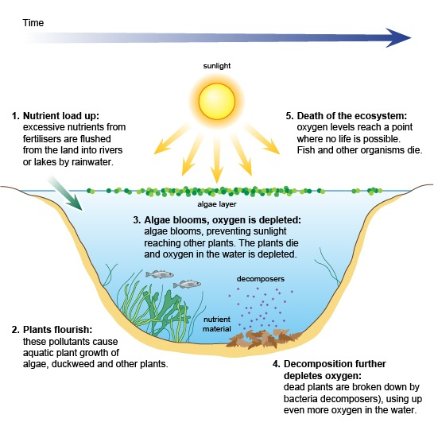

Eutrophication:
Side effects of Fertilizers
5. Death of the ecosystem: low oxygen level kills marine life
1.Nutrient load up:
Flushed from land into water basins
Aquatic Dead Zones
3.Algae Blooms: blocks sunlight from reaching plants
2. Plants flourish: excessive algae growth
Mississippi River
4.Decomposition: further depletes oxygen from aerobic bacterial activity
La Jolla
Source: BBC Science
Algal bloom caused by excessive nutrients such as: nitrates and phosphates from intense agriculture and fertilizer use.
46

Slide 47
World Biofuel Production
Corn, sugarcane, beets
Rapeseed, Soy, Palm Oil, Other fats and Oils
Source: Renewables 2011 Global Status Report (Paris: REN Secretariat)
Source: USDA-FAS
47

Slide 48


Source: EIA
- Recycles oil and provides San Diego with a high quality alternative fuel that is made from local resources.
48

Slide 49

Biofuels and the Cost of Food
“The price of corn in your corn flakes and other retail products is so small that even tripling crop prices has little effect at U.S. grocery stores. But world's poor does not eat processed corn flakes; they spend more than half of their incomes on staples such as corn meal.”
-Tim Searchinger, Research Scholar Princeton University
49

Slide 50

Biofuels and the Cost of Food
“Central America is vulnerable to economic riptides related to U.S. corn policy. The United States is using 40 percent of its crop to make biofuel, it is not surprising that tortilla prices have doubled in Guatemala, which imports nearly half of its corn.”
Source: NY Times “As Biofuel Production Grows, So Do Guatemala’s hunger Pangs”
Guatemala:
Eggs have tripled in price because chickens eat corn feed.
Families spend about 70% of their income on food.
More land is dedicated to growing palm and sugar cane for biofuel, pushing poor families off farms.
Roughly 50% of children are chronically malnourished (not necessarily because of biofuels)
50

Slide 51


The Future of Biofuels
Creating a resilient food supply
First Generation: Made from sugars, oils, and animal fats that use already known processes or technologies. Ex. Biodiesel.
Second Generation: Made from non-food crops or agricultural waste. Ex. Switch grass, willow, or wood chips.
Third Generation: Made from Algae or other quickly growing source like: eucalyptus trees “designed” with low lignin content, allowing for easier conversion to cellulosic ethanol.
Fourth Generation: Made from engineered plants or biomass or are able to be grown on non-agricultural land or bodies of water. Result is carbon-negative
Source: Cornell University
De-link food and biofuel production
51

Slide 52



Reducing Footprint
How to improve food resiliency on a personal level
Buy Local – buying food produced close to home reduces carbon emissions from transportation, is fresher and supports local business
Consume responsibly– choose biodegradable packages, processed foods use lots of energy and are prejudicial to health.
Backyard gardening – one probably won’t be able to live off of your backyard but home gardening is a good way to understand food and make a small difference.
Life Cycle
52

Slide 53


Host and Sponsor
Hosted By:
Sponsored by:
53

Slide 54

Special Thanks to Our Partners
54

Slide 55
Further Information
Camille Castillo cecastillo20@gmail.com
Erin Johnson erinjohnson@umail.ucsb.ed
Abraham Pinheiro apinhei2@asu.edu
Won Mo Yang wmyang0910@gmail.com
55

