Slide 1

Key Take-Away Points from the Film

Slide 2
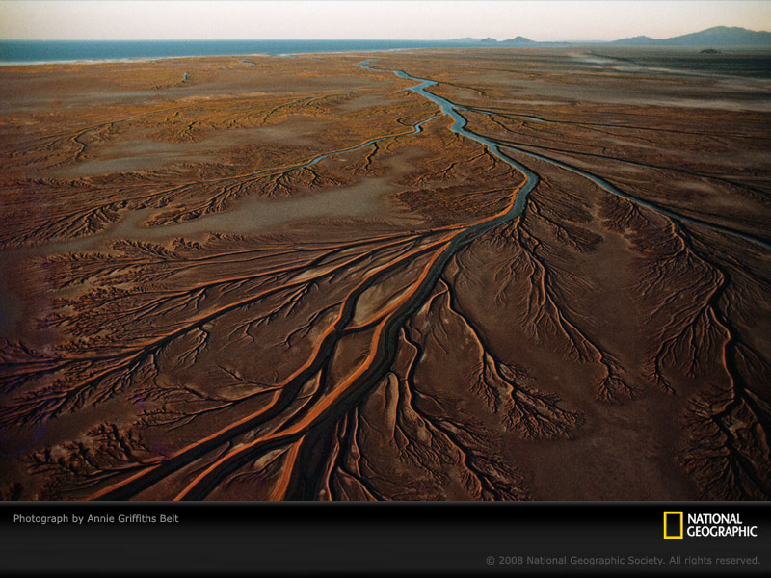
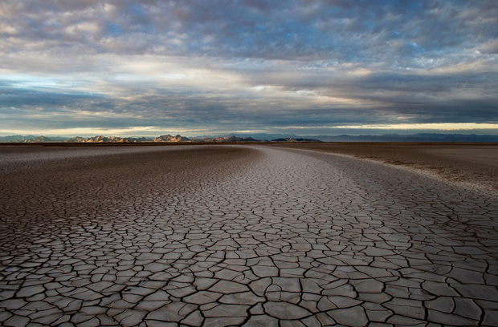
Dried River Basin
The Colorado River used to run in through the ocean until 1998
Since then the river hasn’t reached it’s delta
2% increase in water will allow the Colorado River to reach it’s delta and increase wetlands, which were reduced by 95% when the dam was built

Slide 3
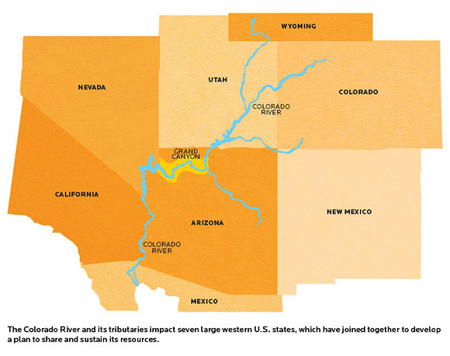
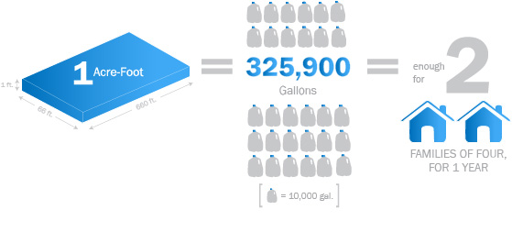
Water Supply
The Colorado River runs through 7 states, which supplies water for 3 billion people
Average person in basin uses over 200 gallons of water a day vs. average Navajo used 60 gallons a day
The Navajo learned water conservation from their elders

Slide 4
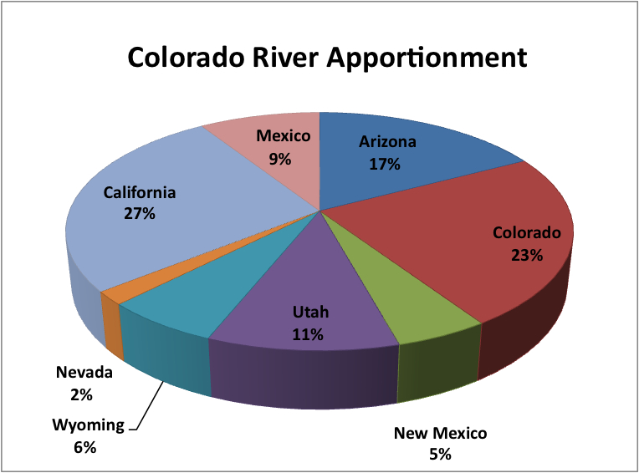

Slide 5
Water Usage
60% of clean water is used on landscaping
Fossil fuel extraction and processing uses 57 billion gallons of water from the Colorado River yearly
That is about 174,926 acre feet of water
15% of the Colorado River is used on Cities and Industries
The demand of the water is soon going to out compete for it’s supply

Slide 6
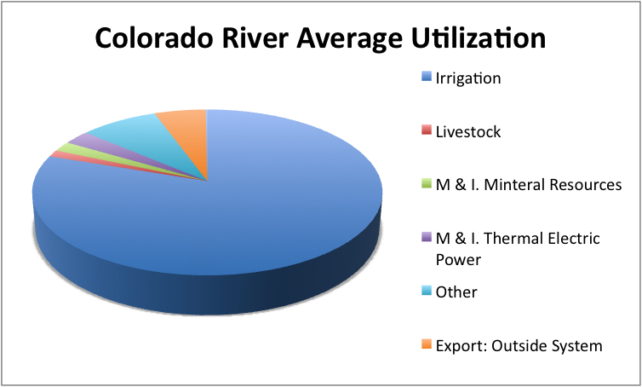

Slide 7
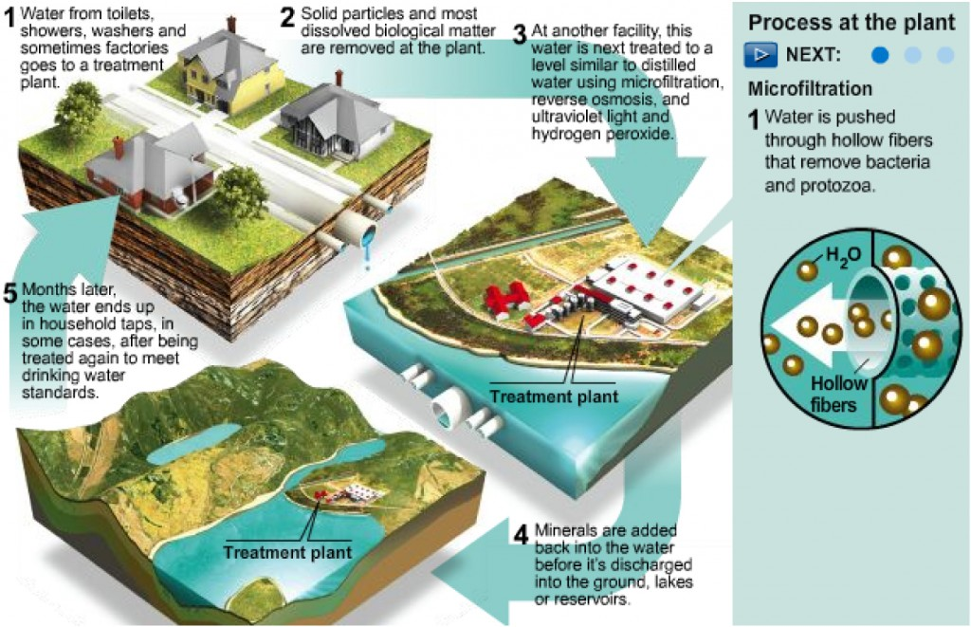
6 billion gallons of fresh, drinking water is used to flush a toilet. Rather than wasting clean water, here is how it could be recycled.

Slide 8
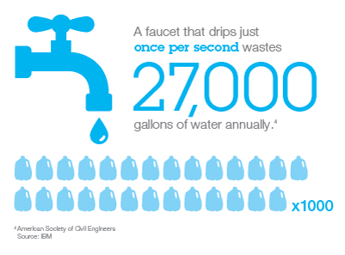
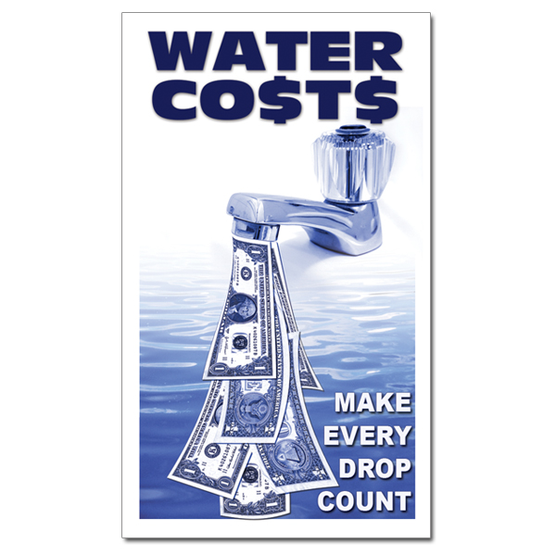
Ways to Save Water
Fix leaky faucets
Grey water is a great way to recycle and conserve
Collect extra shower water and use it to water plants vs. using sprinkler system
Charge extra for wasted water
If there was a higher price, people wouldn’t want to waste as much and will learn to have more appreciation for water
This is currently done in Minnesota

Slide 9
Sources
Slide 1:
http://watershedmovie.com/
Slide 2:
http://photography.nationalgeographic.com/photography/enlarge/mudflat-colorado-river-delta.html
http://ngm.nationalgeographic.com/visions/field-test/chasing-water#/2
Slide 3:
http://bv.com/Home/news/thought-leadership/water-issues/making-the-colorado-river-sustainable-for-seven-states
http://greatecology.com/san-diegos-water-plan-30-year-agreement/
Slide 4:
http://web.mit.edu/12.000/www/m2012/finalwebsite/problem/coloradoriver.shtml

Slide 10
Sources
Slide 5:
http://www.flickr.com/photos/uniontribgraphics/8078740987/
Slide 6:
http://web.mit.edu/12.000/www/m2012/finalwebsite/problem/coloradoriver.shtml
Slide 7:
http://wwd.surfrider.org/2011/from-toilets-to-tap-how-we-get-tap-water-from-sewage/
Slide 8:
http://www.ibm.com/smarterplanet/ca/en/water_management/ideas/index.html
http://www.awarenessideas.com/AI-whmag006-Water-Costs-Make-Every-Drop-Count-p/ai-whmag006.htm
Presentation By: Brittany Fischer

